Slide 1
Report of CAROSAI
INTOSAI Capacity Building Committee
9-11 September Lima, Peru

Slide 2
CAROSAI Mission and Values
Mission
To promote and support effective Public Sector audit and enhance accountability
Vision
A leading regional organization recognized for its excellence in facilitating effective auditing through the sharing of resources and ideas.

Slide 3
CAROSAI
Founded in 1988
Executive Council
4 Committees
Secretariat
Director General – Director of Audit, St Lucia
Admin Assistant – Funded by Govt. of St Lucia
Financial resources
Sustainable????

Slide 4
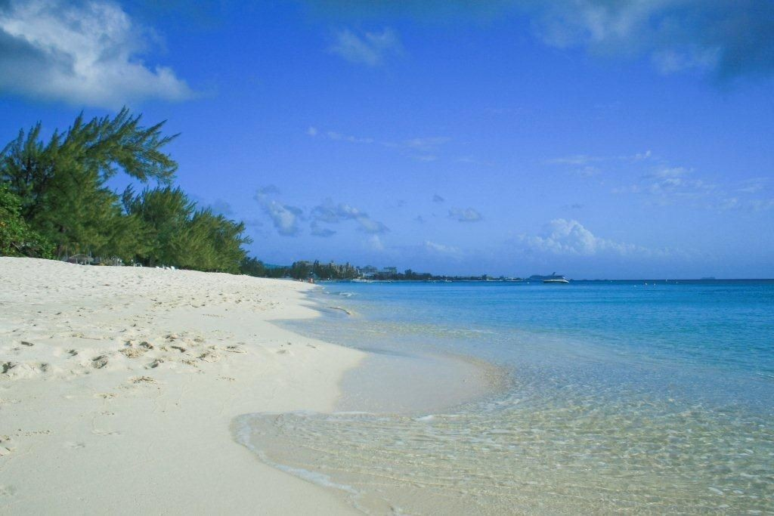

Slide 5
General Characteristics
English speaking Caribbean
SAIs generally small in size, three larger (>100)
Majority island states
5 members are Overseas Territories of the UK

Slide 6
CAROSAI Members
Anguilla
Antigua
Aruba
Bahamas
Barbados
Belize
Bermuda
British Virgin Islands
Cayman Islands
Dominica
Grenada
Guyana
Haiti
St. Vincent
Jamaica
Montserrat
Suriname
St. Kitts
St. Lucia
St. Maarten
Turks & Caicos
Trinidad & Tobago

Slide 7
Diversity of Members
Majority (18) operating under the Westminster model
Report to the legislature
Various stages of development
Independence
Mandate
Professionalisation
Audit practices

Slide 8
Independence
Constitution or specific legislation
Outdated
Constraints
AG appointment until retirement
Mandates
Operational independence
Can determine scope of work etc.

Slide 9
Independence
Limited administrative independence
Departments of core government
Staff appointed though Public service commission
Finance Ministries controlling financial resources
Public reporting constrained
Small states – conflicts, influence
Staff resistance
Constraints/ability to deliver Mandate

Slide 10
Working to improve
Model legislation developed
Revised legislation in process of implementation
Advocacy
Working with Public Accounts Committees
Working with Donors
Challenge to get it on the Legislative Agenda

