Slide 1
SAI Engagement with External Stakeholders
Effective Institutions Platform
Joint Secretariat OECD-UNDP
Stockholm, CBC INTOSAI meeting
10 September 2015

Slide 2
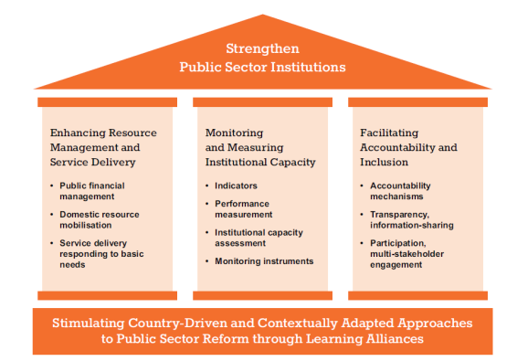
Effective Institutions Platform
Multi-stakeholder alliance of over 60 countries and organizations established in 2012 engaged in public sector reforms (not only government representatives, but also CSOs, legislators, think tanks)
Bases its work on a methodology:
P2P Learning Alliances
3 Major Pillars of work
Website:
www.effectiveinstitutions.org
Notes:
The EIP is a multi-stakeholder alliance of over 65 countries and organisations focused on strengthening public sector reforms and supporting evidence-based learning in this area.
It bases its work on ways in which organisations, agencies, countries learn from each other in the realm of the public sector (that is to say in an environment which requires technical and political skills and knowledge).
There are three main areas of work focusign on resource management and service delivery; on measuring institutional capacity; and facilitating accountable and inclusive institutions. The project on SAIs falls under the third pillar.

Slide 3
Engaging Citizens in Accountability Institutions
The Proposal (February 2013): EIP received a proposal from the Auditor General office of South Africa in cooperation with the SAIs of Brazil and Chile, OECD-DAC, and IDI to develop a work stream on citizen engagement with SAIs.
Background: Global commitments and regional standards recognise:
Importance of external stakeholder engagement (parliaments, citizens and media)
Need to go beyond traditional engagement mechanisms
Role that development cooperation can play
Civil society increases demand for using and contributing to accountability work
Project under the EIP initiated since 2013 to review Supreme Audit Institution (SAI) engagement practices and to develop practical guidance:
Phase I: stock take of SAI and citizen engagement (32 SAIs); 2013-2014
Phase II: checklist on engagement with different stakeholders (citizens, parliaments and the media) with global survey and case studies; 2015-2016.
P2P Learning Alliance in October 2014 (Paris) to discuss benefits and risks of SAIs engagement (7 SAIs: Brazil, Costa Rica, Chile, France, Philippines, South Africa, Zambia with CSOs and representatives of development partners)
Notes:
IN line with the principle of being driven by the demands and needs of its members, the EIP received from the Auditor General office of South Africa in cooperation with SAIs of Brazil and Chile, OECD-DAC, and IDI a proposal to develop a stream work on Citizen engagement with SAIs.
The rational for this proposal comes from SAIs work through International (UN resolution A/66/209) and regional bodies recognising the importance of external stakeholder engagement, and the need to go beyond traditional one way relationship between SAIs and external stakeholders- but rather it is a on two way relationship. Global commitment (SDG 16.6 develop effective, accountable and transparent institutions at all levels) reflect the development cooperation responsibility in supporting national accountability bodies. In addition the demand for accessible information from accountability bodies comes also from civil society which not only can use information on government audits, public financial management, value for money criteria in public spending etc. but has grown capacities of contributing to produce it, in this sense remarkable work is done through the country strategies of the Open Government Partnership.
As a result in 2013, a Steering Group (comprised of: Brazil, South Africa, Chile, Costa Rica, IDI, New Zealand, Philippines, OECD) launched under the Effective Institutions Platform, a project
To draft Stocktake on how SAIs engage external stakeholders involving 32 SAIs. The results are available on the EIP website and will be providing some highlights in the next slides.
The stocktake findings helped identified a series of gaps and areas for further analysis, which are being addressed in the second phase
2nd Phase (2015-2016): Towards a Checklist for engagement practices with Parliaments, Media and CSOs.
Survey on SAI’s engagement practices (survey launched in july 2015 to a large sample group, open for other respondents. conclusions expected by September 2015);
Case-Study: several SAIs will be chosen as case studies to compare their engagement practices;
Follow-up report with Checklist (October 2015).
Conclusions will be presented to the XXVth OLACEFS General Assembly (23-27 november 2015 Mexico).
-Learning Alliance on Stakeholder Engagement
workshop really focused on country experiences and sharing their inputs into the challenges and opportunities for engagement. We had two presentations by Costa Rica and the Philippines and the group work and plenary discussions. At the end of the days, Nick Manning came to get some insights from participants regarding the learning alliance model
A first learning alliance workshop was held in October on this issue of Supreme audit institutions and citizen engagement. It brought together 7 Supreme Audit Institutions (SAIs) (Brazil, Costa Rica, Chile, France, Philippines, South Africa, Zambia) with CSOs and representatives of development agencies to identify and share good practices on citizen engagement with SAIs.
The LA was the opportunity to share their experience in engaging with external stakeholders, as well as their expectations in relations to possible outcomes of a learning alliance on this subject. During the discussion some SAIs (Costa Rica and Philippines) Participants also identified critical questions that a LA should address: how to design effective citizen engagement strategies, how to build trust between SAIs and other actors. One of the points addressed how LA can take into account the very different contexts in which SAIs perform their functions. Furthermore the participants gave their feedback on the template for documentation of country practices, which will be one of the cornerstones of the next phase of the work on SAIs and citizen engagement.
Learning alliance to be launched in October

Slide 4
Next steps: how can you get involved?
Survey contribution: survey is open to all SAIs until September 24th 2015 to map a sample of SAIs engagement practices as broad as possible;
Case studies: to document good lessons and challenges in engaging with external stakeholders. From October 2015;
Checklist: future reference to SAIs for designing their engagement strategies. To be presented together with the report in November 2015;
Second Learning Alliance Workshop (October 2015): a long-term learning engagement including face-to-face and long-distance events.
Notes:
Survey: by developing a more extensive framework the result of the survey should allow to map types of SAIs engagement with media, parliament and citizens.
Case studies: a template was discussed during the first learning alliance workshop as well as the criteria for selecting the cases. It was retained that the EIP should not only consider success stories but also other practices that may offer important learning insights even if they have faced challenges
Based on the preliminary results of the survey, several 4 case studies will be launched to document some of the most interesting practices: success or failure, innovative, or the efforts of SAI in conflict environment such as the case of Afghanistan.
Checklist: that should serve as future reference when SAIs design their engagement strategies EXAMPLES of what could be a recomandation of the checklist?
The intention is to build on this first LA workshop and organize follow-up events in 2015/2016, including face-to-face events as well as online peer learning activities between these. A discussion may be initiated during the annual forum of the OLACEFS taking place in Mexico in October 2015.
Future events under this learning alliance (which are long-term arrangements, not just 1 workshop) will focus on the enabling environment and developing risk mitigation strategies for citizen and other stakeholder engagement.
How to match the peers given the difference in mandates and environment in which SAIs operate?
How to build trust between learning alliance members?
Should external actors participate to the alliance?

