Slide 1
Capacity Building Committee Annual Meeting
SAI Capacity and Relevance in a Post 2015 Development Agenda Perspective
The SAI Sierra Leone View
By Lara Taylor-Pearce, Auditor General

Slide 2
Sierra Leone at a Glance
48
Life expectancy at birth
5.9
Million people
More than
4,000
Ebola deaths
70%
Youth unemployment
2 Million displaced
10,000 deaths
1991 - 2002
41%
Literacy
119/175
2013 TI Corruption Perception Index
60%
Live on
less than
$1.25 a day
2.8%
Annualised
contraction rate
in the economy
More than
$400m
GDP 2014

Slide 3
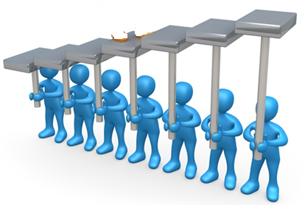
Sierra Leone and the MDGs
Despite significant recent political and socio-economic achievements, Sierra Leone will not meet its targets for the Millennium Development Goals (MDGs) by 2015
UN Report

Slide 4
CIVIL SOCIETY PERSPECTIVE
MDGs directed attention to key development issues.
They have led to collaboration and dialogue on national priorities.
MDG framework was not explicitly connected to systems of accountability and resourcing.
Process is less inclusive when compared to those for other programs.
Unrealistic and inappropriate for the national context.

Slide 5
CIVIL SOCIETY ORGANISATIONS (CSOs)
Lack specialised knowledge and research capacities.
CSOs have been less active in monitoring and advocacy.

Slide 6
SAI Challenges
Resource allocation divert attention from matters of concern and may bring about unintended outcomes.
“What gets measured gets done.”
Criticism of public policy is broadly outside the SAI’s remit.
Less than perfect public policies present challenges for creative audit approaches.

Slide 7
Audit Service Sierra Leone Capacity
Level 3 – AFROSAI-E Institutional Capacity Building Framework.
Technically well-functioning
Highly regarded.
One of the best-performing public sector organisations.
Increasing international recognition.
Better quality in audit work.
Have a functioning Performance Audit unit
Level 1
Little Independence
Little human capacity
No engagement with stakeholders.
Unclear auditing standards and methods.
Focused on financial, compliance and regularity audits.

Slide 8
Audit Service Sierra Leone…the reality
Non-implementation of audit findings and recommendations.
Full effect of audit interventions in MDGs not achieved.
Technical strength is not enough.
Parliamentary promotion of transparency not effective.
Power in the voice of the people.

Slide 9
Audit Service Sierra Leone
What we can do better.
Design audit programs with appropriate scope to include SDG indicators.
Do not question the political will of parliament regarding policies for SDGs.
Go beyond verification of SDG expenditure.
Engage in multi-disciplinary financial, compliance and performance audits over the life cycle of SDGs.
Engage with civil society to create momentum and pressure for institutional reform.
Embrace a robust communication strategy.

Slide 10
What does ‘accountability’ really mean?
Laws relating to accountability should be enforced.
Public officials should practice what they are appointed to do.
They should feel an obligation to justify and explain their conduct.
SAIs should make fair and balanced audit recommendations.

Slide 11
The way forward for SAIs
There should be systems for reward and sanctions for auditees and other related stakeholders when necessary.
SAIs should be technically competent.
The leadership of SAIs should have a good but not compromising relationship with the political elite.
There must be pressure for reform.

Slide 12
The End
Thank You
Audit Service Sierra Leone

