Slide 1
Parallel Session
CBC Work Stream – IntoSAINT
2017 Meeting of the INTOSAI Capacity-Building Committee
September 18 - 20, 2017
Washington, DC (World Bank’s premises)
Supreme Audit Institution of Mexico
on behalf of the IntoSAINT Project Group
IntoSAINT | 1

Slide 2
IntoSAINT
CBC perspectives
Progress Report – 2017
Regional case study – lessons learned
Comments, questions, suggestions by participants
Relevance for capacity building

Slide 3
IntoSAINT
CBC perspectives
Progress Report – 2017
Regional case study – lessons learned
Comments, questions, suggestions by participants
Relevance for capacity building
CBC perspectives

Slide 4
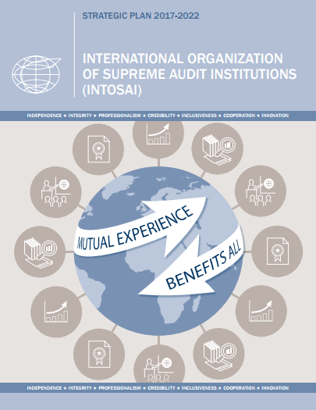
Capacity Building Committee
Mandate
INTOSAI Strategic Plan 2017-2022
Support SAIs in developing capacity to maximize their value and benefits to society, by:
  (1) Promoting the development of capabilities and professional capacities of independent SAIs and regional organizations;
  (2) Informing INTOSAI decision-making on SAI capacity development matters, and
  (3) Cooperating with donors, relevant partners, and stakeholders.

Slide 5
Capacity Building Committee
Perspectives on IntoSAINT
Each individual SAI has the primary responsibility for identifying and addressing its own capacity development needs based on its strategic and related development plans.
These strategic and development plans can be informed by:
a SAI Performance Measurement Framework (SAI PMF) assessment,
the SAI Self-Assessment of Integrity (IntoSAINT),
peer review results,
feedback from clients and stakeholders,
the desire to more effectively support the development of accountable national institutions (SDG 16) and contribute to the follow-up and review of national sustainable development initiatives, consistent with the 2030 Agenda for Sustainable Development.
Additional tools and assessments.
INTOSAI seeks to ensure that each of INTOSAI’s member SAIs benefit from capacity-development initiatives, as relevant to their needs.

Slide 6
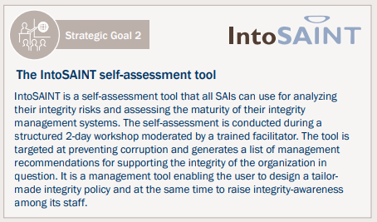
Capacity Building Committee
Perspectives on IntoSAINT
Nine (9) Key Strategies to Achieve Goal 2 and Strategic Objectives
  #6. Advocate for and encourage the use of the IntoSAINT integrity tool to support SAIs as models of integrity, transparency and Accountability

Slide 7
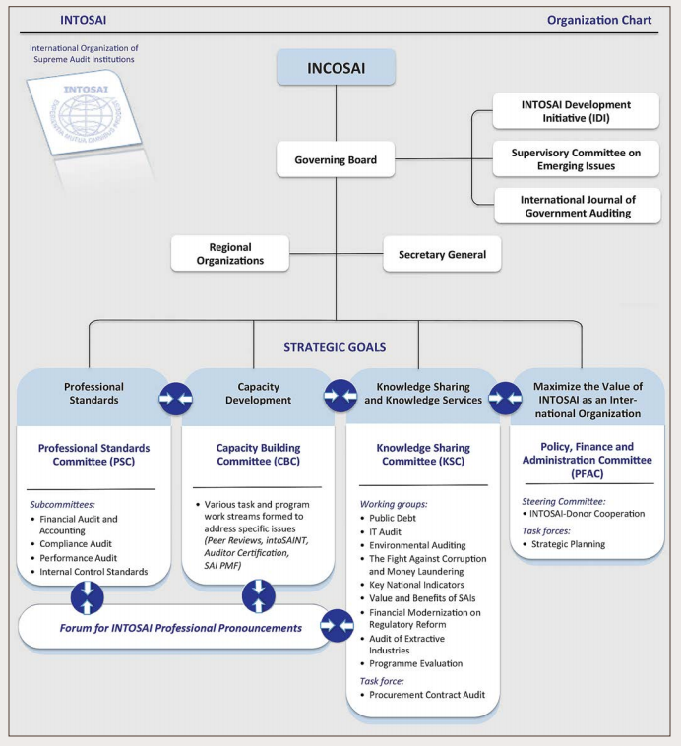
Capacity Building Committee
Perspectives on IntoSAINT
IntoSAINT Project Group
Promote the implementation of the IntoSAINT tool worldwide
Foster its continuous improvement
Knowledge-sharing efforts among key actors
Tool contributing to SAIs capacity building
“A tool that supports SAIs as models of integrity, transparency and accountability.”

Slide 8
IntoSAINT
CBC perspectives
Progress Report – 2017
Regional case study – lessons learned
Comments, questions, suggestions by participants
Relevance for capacity building
Progress Report – 2017

Slide 9


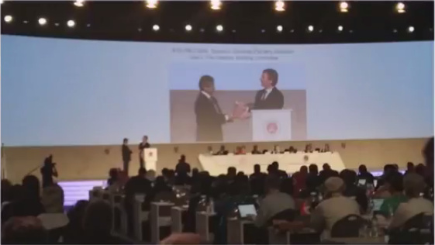
CBC IntoSAINT Project Group
XXII INCOSAI – Chair Transition
SAI of Mexico
NCA

Slide 10
CBC IntoSAINT Project Group
Workstream members
Cameroon
Fiji
Indonesia
Mexico (Chair)
Netherlands
South Africa
Tunisia
ECA
IDI
New members are welcome!

Slide 11

CBC IntoSAINT Project Group
Challenge Identification

Slide 12
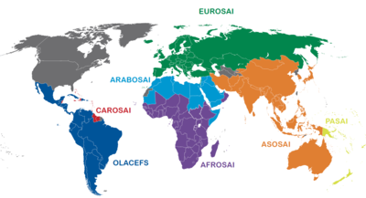
CBC IntoSAINT Project Group
Challenge Identification
Regional focal points
Link with a specific regional committee
Statistical analysis in regions
Challenge 1: How to get regions on board

Slide 13
CBC IntoSAINT Project Group
Challenge Identification
Challenge 2: Funding
Donor Community
Effective strategy to get financial resources (result-oriented approach)

Slide 14
CBC IntoSAINT Project Group
Challenge Identification
Challenge 3: How to share knowledge among parties
Knowledge sharing
Moderators
SAIs
INTOSAI Bodies
Public Institutions
Donors
Other Key Stakeholders

Slide 15
CBC IntoSAINT Project Group
Challenge Identification
Challenge 4: Updating mechanisms and sustainability
Ownership
IntoSAINT at a higher level in INTOSAI (Strategic Plan 2017-2022)
Sustainability in the long-run

Slide 16

CBC IntoSAINT Project Group
Challenge Identification
Challenge 5: Follow-up mechanisms
Real success on the tool
Implementation of the recommendations stemmed from the self-assessments
Monitoring system on real impact in terms of effectiveness should be in place!

Slide 17

CBC IntoSAINT Project Group
Challenge Identification
Challenge 6: Communication strategy
Multimedia material
KSC-IDI Community Portal
Regional Magazines
INTOSAI Journal
CBC Website
INTOSAI Website
Webinars
Social Media

Slide 18
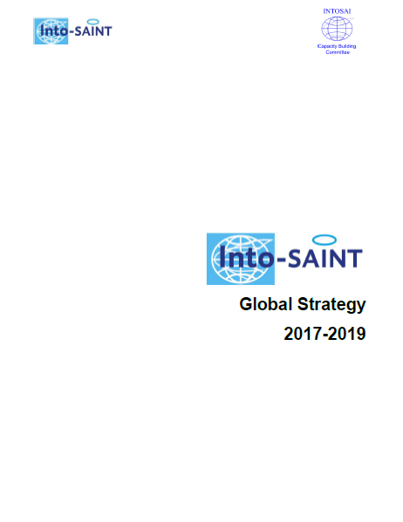
CBC IntoSAINT Project Group
Global Strategy 2017-2019
Four strategic objectives:
Objective 1: Awareness-raising of the tool
Objective 2: Implementation of IntoSAINT workshops
Objective 3: Sustainability of the tool
Objective 4: Promotion of SAINT

Slide 19
CBC IntoSAINT Project Group
IntoSAINT in numbers so far
+ 170 moderators from 68 countries have been trained
Self-assessments in around 40 countries

Slide 20
IntoSAINT
CBC perspectives
Progress Report – 2017
Regional case study – lessons learned
Comments, questions, suggestions by participants
Relevance for capacity building
Regional
Case Study

Slide 21

CBC IntoSAINT Project Group
Case study: the OLACEFS experience

Slide 22
CBC IntoSAINT Project Group
Case study: the OLACEFS experience
Aspect | How it was addressed in OLACEFS
Objective 1: Awareness-raising of the tool
Outreach activities | Articles on the value and benefits of the tool have been published on the OLECEFS newsletter, magazine and website. Video clips have been also published on the website, and submitted to the Technical Commission on Good Governance (CTPBG) and to the Regional Capacity-Building Committee (CCC). Materials have been prepared for the INCOSAI seminars and booths.
Collaboration ties | The implementation of IntoSAINT was considered into the OLACEFS Technical Commission on Public Ethics, Probity and Transparency (CEPAT)’s Annual Working Plans, and since 2014 into the CTPBG’s. Progress on the IntoSAINT implementation was presented before the OLACEFS General-Assemblies and Governing Board meetings.
Working material | The original material was translated into Spanish, and then enriched after the first experiences of the tool implementation. Then, from the updated Spanish versions, the material was translated into Portuguese.

Slide 23
CBC IntoSAINT Project Group
Case study: the OLACEFS experience
Aspect | How it was addressed in OLACEFS
Objective 2: Implementation of IntoSAINT workshops
Funding | Most of the IntoSAINT workshops were based on a joint financial scheme: with financial contributions from the Inter-American Development Bank (IADB); the German Cooperation (GIZ); CTPBG’s, as well as SAIs’. These financial resources were used for covering the moderators’ expenses of flight tickets, accommodation and meals.
Advisory services | The SAI of Mexico was responsible for the implementation of the tool in OLACEFS when it chaired CEPAT, and also after the establishment of CTPBG, as project coordinator with its Chair (SAI of Argentina). The SAI of Mexico provided the OLACEFS SAIs with guidance through videoconferences on the planning, execution of the tool, as well as on the assessment report drafting.
Planning of the workshop | Moderators received advisory services in advance from the regional project coordinator on the planning phase. For the logistical arrangements, coordination with the OLACEFS Secretary-General was necessary, since all purchases were made by this entity (as it is legally in charge of administering the OLACEFS budget).

Slide 24
CBC IntoSAINT Project Group
Case study: the OLACEFS experience
Aspect | How it was addressed in OLACEFS
Objective 2: Implementation of IntoSAINT workshops (cont.)
Execution of the workshop | An annual call was launched in 2015, 2016 and 2017 to invite SAIs to implement the IntoSAINT Tools, regarding the available financial resources for that year. Moderators received advisory services in advance from the regional project coordinator on the execution phase. A workshop coordinator at the self-assessed SAI was appointed to facilitate the logistics, and the local moderators were also involved during the execution of the workshop. Up to date, 17 OLACEFS member SAIs have implemented the IntoSAINT tool. By November 2017, the SAI of Curazao will have implemented the workshop, reaching this way a total of 18 (out of 22) OLACEFS member SAIs by the end of this year with progress on IntoSAINT.
Draft and presentation of the report | Moderators received advisory services in advance from the regional project coordinator on the draft and presentation of the report.
Follow-up mechanisms | Taking into consideration that the report is confidential and exclusively intended for use by the self-assessed SAI, a survey with general questions on integrity mechanisms within the OLACEFS members will be carried out in the last quarter of 2017. This information will allow us to make data analytics for decision-making purposes.

Slide 25
CBC IntoSAINT Project Group
Case study: the OLACEFS experience
Aspect | How it was addressed in OLACEFS
Objective 3: Sustainability of the tool
Moderators training | In 2013, a moderators training was carried out by CEPAT, with the support of the Netherlands Court of Audit, and the CCC. The training program was divided into two phases: a six-week virtual phase with readings and exercises for the participants, and a two-day, in situ encounter held in Mexico City to reinforce knowledge. 30 moderators from 19 SAIs were certified.
Knowledge sharing | After the moderators training, videoconferences to share challenges and good practices among moderators were held. At the XXV OLACEFS General Assembly, held in Queretaro City, Mexico, in November 2015, a publication written by the regional moderators was presented. The publication is titled: The Relevance of the Promotion of Integrity in Public Sector Institutions in Latin America and the Caribbean. Perspectives, Progress and Good Practices on the Integrity Self-Assessment Tool (IntoSAINT) in OLACEFS.

Slide 26
CBC IntoSAINT Project Group
Case study: the OLACEFS experience
Aspect | How it was addressed in OLACEFS
Objective 4: Promotion of SAINT
Working materials | Spanish materials were updated in 2017 in order to make them applicable both to Integrity Self-Assessments in SAIs (IntoSAINT) and in public sector organizations in general (SAINT).
Advisory services | The SAI of Mexico, as regional project coordinator, will keep offering advisory services to the OLACEFS member SAIs for implementing SAINT workshops.
Implementation | The SAI of Chile has implemented SAINT workshops in 2015 and 2016. A videoconference will be held on September 21, 2017, with OLACEFS member SAIs to launch this year a SAINT workshop in the region with CTPBG’s financial resources.

Slide 27
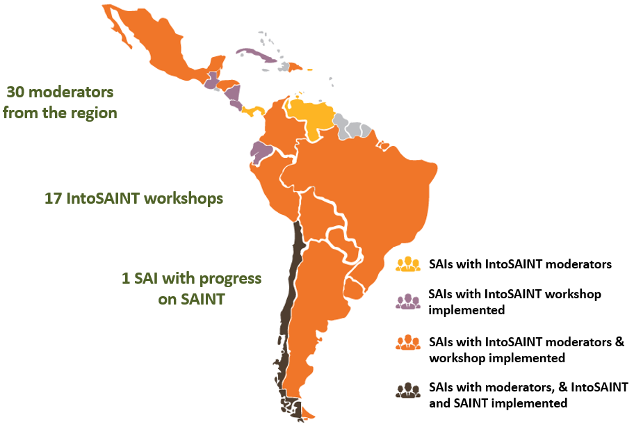
CBC IntoSAINT Project Group
The implementation of IntoSAINT in OLACEFS (Sept 2017)

Slide 28
IntoSAINT
CBC perspectives
Progress Report – 2017
Regional case study – lessons learned
Comments, questions, suggestions by participants
Relevance for capacity building
Relevance for Capacity Building

Slide 29
CBC IntoSAINT Project Group
Motions
1. To take note of the workstream’s progress report
2. To endorse the IntoSAINT Global Strategy, which establishes the workstream’s objectives for the 2017-2019 period

Slide 30
IntoSAINT
CBC perspectives
Progress Report – 2017
Regional case study – lessons learned
Comments, questions, suggestions by participants
Relevance for capacity building
Comments, questions, suggestions

Slide 31

CBC IntoSAINT Project Group
The floor is open…

Slide 32
Parallel Session
CBC Work Stream – IntoSAINT
2017 Meeting of the INTOSAI Capacity-Building Committee
September 18 - 20, 2017
Washington, DC (World Bank’s premises)
Supreme Audit Institution of Mexico
on behalf of the IntoSAINT Project Group
IntoSAINT | 32

