Slide 1


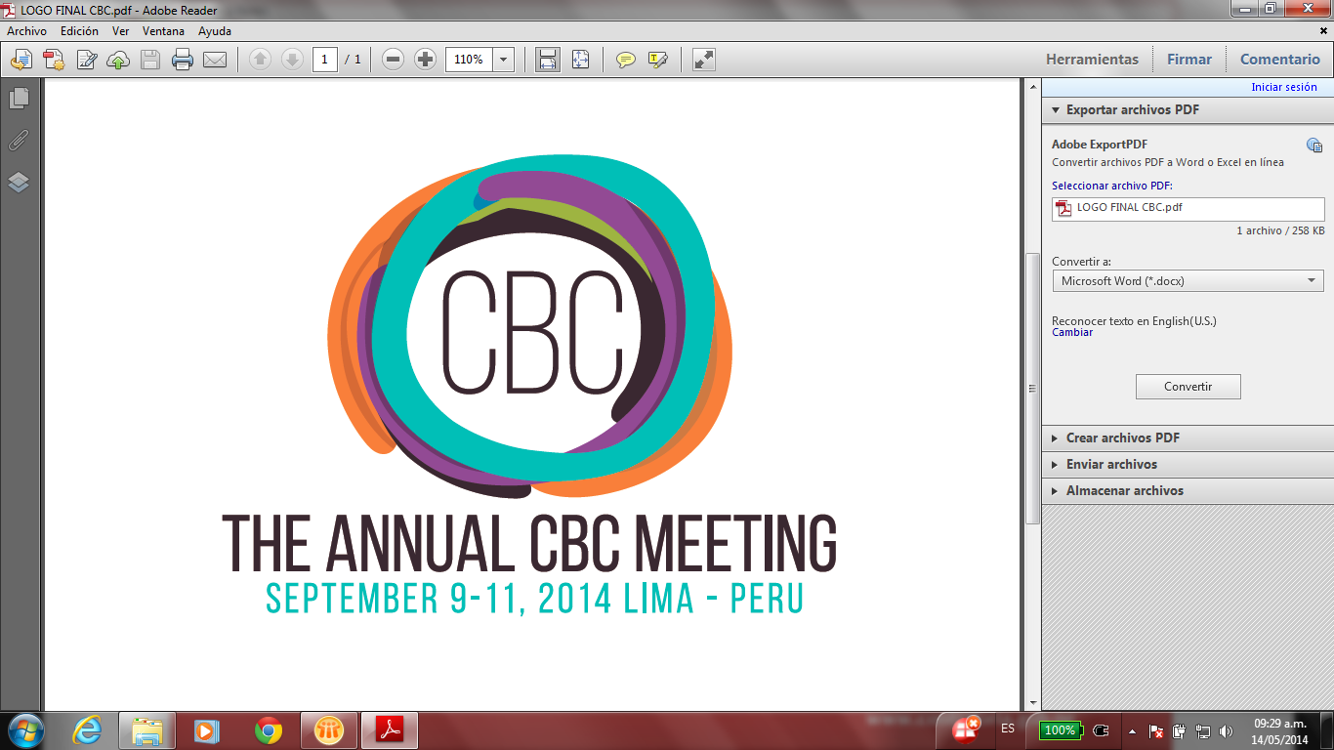
PEER REVIEW
Quality Assurance Tool for SAIs
Supreme Audit Office of the Slovak Republic,
Chair of the CBC Sub-Committee
Promote Peer Reviews

Slide 2


Content of the presentation
CBC Sub-Committee
E-mail survey 2014 on peer review

Slide 3

Peer Review benefits all

Slide 4


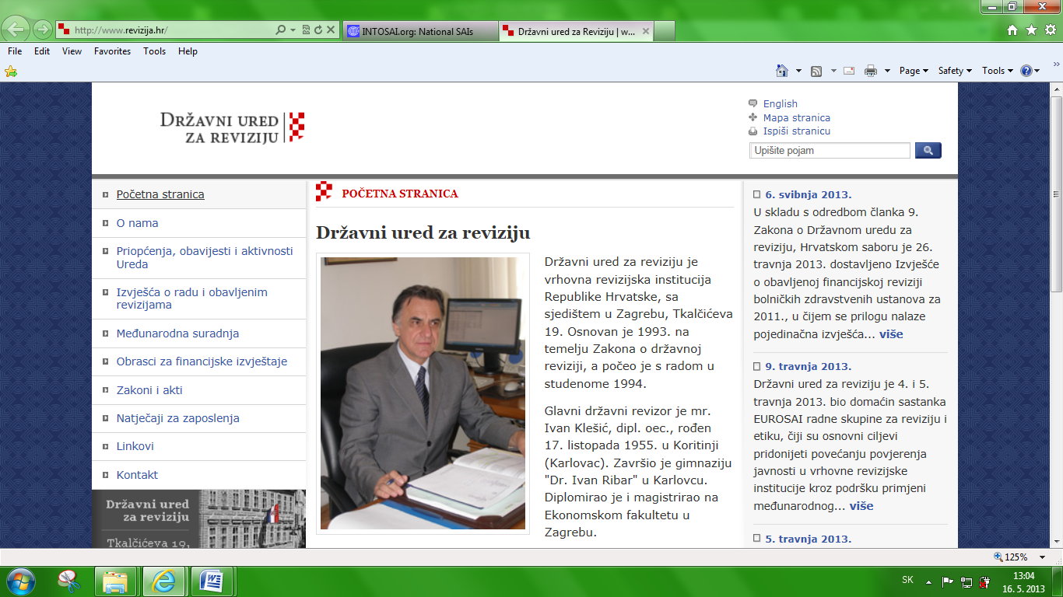
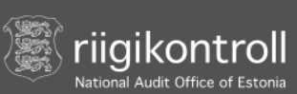









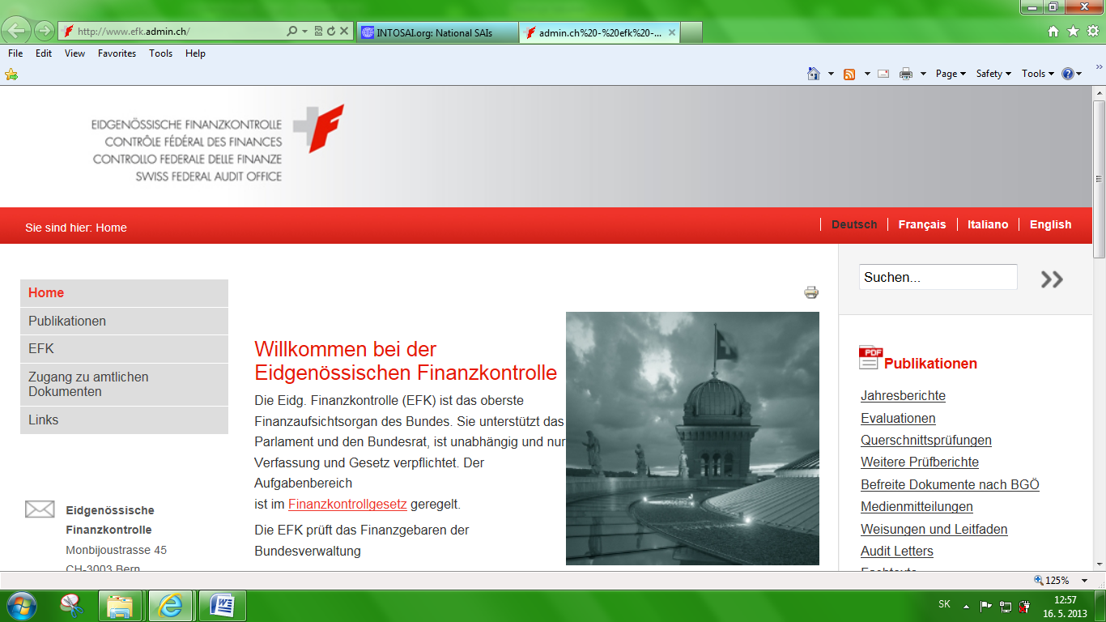
CBC Subcommittee 13 members
Chair: Slovakia Vice-Chair: Bangladesh
SAI members:
Austria Croatia Estonia European Court of Audit Germany
Hungary Indonesia Morocco Poland Sweden USA
Cooperating organisations and partners:

Slide 5
CBC Subcommittee
  CBC Subcommittee promotes best practices and quality assurance through voluntary peer reviews by:
  Assessing and documenting existing peer reviews
  Fostering environment where SAIs are aware of the benefits arising from voluntary peer reviews,
  Updating the Peer Review guide and Checklist
  Disseminating peer review results

Slide 6

What is new
since
INCOSAI 2013?

Slide 7
E-mail survey 2014 on peer review
within INTOSAI community
  Execution: January 13th till March 31st
  Questionnaires sent to and received by 170 INTOSAI members
  39 SAIs have no web page
  4 members have no e-mail contacts
  46 replies means rate of return was 28 %

Slide 8
The largest number of peer reviews in 2012 – 12 peer reviews
The second richest year was 2014 - 8 peer reviews.

Slide 9
SAI as peer reviewer

Slide 10
4 times - USA
3 times - Canada, Lithuania, Poland
2 times - Bolivia, Botswana, ECA, Estonia, France, Iceland, Indonesia, Mauritius. New Zealand, Norway, Romania, Slovakia, Uganda
Once - Austria, Belize, BiH, Bulgaria, Costa Rica, Czech Republic, Denmark, Ecuador, El Salvador, Finland, FYROM, Honduras, Hungary, India, Iraq. Ireland, Latvia, Mexico, Mongolia, Montenegro, Netherlends, Paraguay, Peru, Sweden, Switzerland, Tanzania.

Slide 11
Some facts about peer reviews
Average size of the peer reviewing team: 5.7 people per team
Average number of days of the reviewing team spent at the reviewed SAI premises: 13.5
There are 41 peer review reports available on the CBC web site: 35 in English, 4 in Spanish and 2 in German.
Topics and scope of the peer review varied widely according to a peer review goal.

Slide 12
Some facts about peer reviews
Number and types of recommendations also varied widely according to the peer review goal and findings.
The peer review recommendations use and their fulfilment were difficult to observe, as majority of the peer reviews weren't followed by the follow-up.
ISSAI 5600 Guide and Checklist were used extensively especially in the peer review preparation stage.

Slide 13
Some general conclusions
and insights of the peer review survey
Peer reviews were judged as helping to provide benefits to all participants.
Peer review helps to hold a mirror to the given SAI audit processes and overall activities.
Peer reviews are becoming more interesting as an assessment tool for the INTOSAI members.
The INTOSAI community should deal with peer review for the sake of its balanced and continuous development.

Slide 14

Peer review brings changes,
but

Slide 15
Thank you for your attention

