Slide 1
PEER REVIEW SURVEY 2015
INTOSAI Capacity Building Committee
Subcommittee on Peer Review
SAI of Slovak Republic
Stockholm, Sweden
8th September, 2015
Presenter: Imrich Gál
International Relations Division

Slide 2
Global
peer review
survey 2015

Slide 3
The yearly global peer review survey 2015
among the INTOSAI members
was conducted according to the
INTOSAI Strategic Plan 2011-2016 and
the CBC Subcommittee on Peer reviews
Action Plan 2013-2016
as noted by the XXI INCOSAI in Beijing 2013.

Slide 4
Peer review survey 2015
was conducted as the third one
after surveys in:
2012 by BRH D
2014 by SAI SK
2015 by SAI SK

Slide 5
Peer review survey process
The survey was undertaken between January and April 2015.
The INTOSAI members were delivered a questionnaire
There were 192 SAIs as INTOSAI members according to data at INTOSAI web.
38 INTOSAI members were without web page.
More SAIs have e-mail contact than their respective web page.
INTOSAI members without any e-mail contacts: 2 (decrease by 2 against 2014 numbers).
Questionnaire was undeliverable to: 12 SAIs.
Assumption - the questionnaire was sent and received at 177 SAIs
The Subcommittee registered 72 replies
The increased number of replies and filled-out questionnaires was, among other factors, due to involvement of the INTOSAI regional working groups and their secretariats

Slide 6
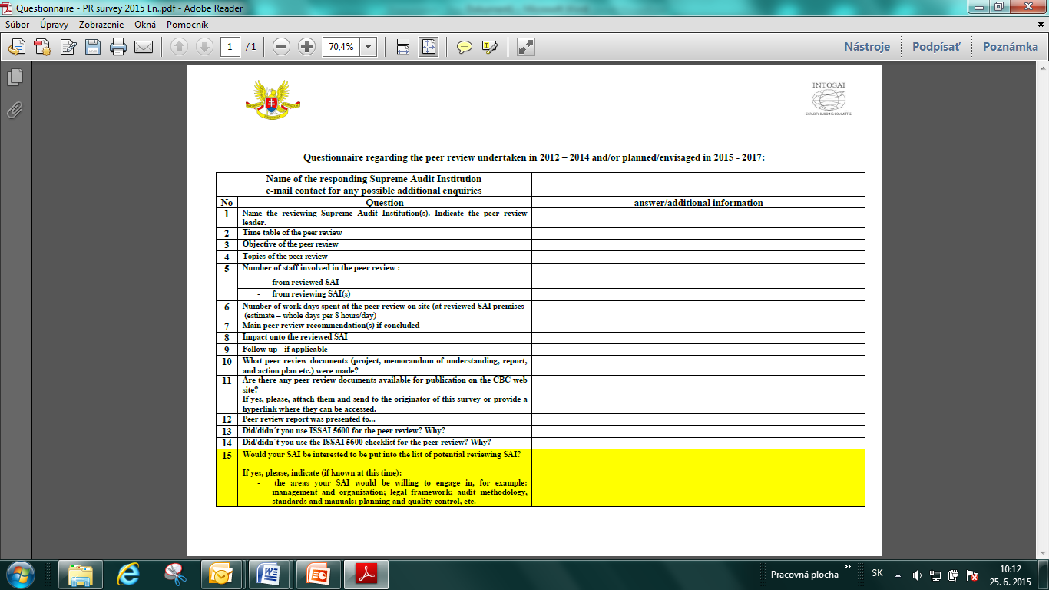
Peer review survey questionnaire

Slide 7
Peer review survey findings
85 peer reviews since 1999 were known to Subcommittee
increase by 19 projects since the survey in 2014
68 peer review related documents. This number breaks further down to 48 reports and 8 memoranda:
 | language | number of reports | number of MoU
 | English | 40 | 5
 | French | 1 | x
 | Russian | 1 | x
 | German | 3 | 2
 | Spanish | 4 | 1
 | total | 49 | 8

Slide 8
The largest number of peer reviews was conducted in 2012 – sixteen. The second year in numbers was 2014 with fifteen peer reviews.

Slide 9
49 SAIs as peer reviewers
participation as peer reviewer | SAI | engagement sub-total
22 | Sweden | 22
21 | Netherlands | 21
20 | Norway | 20
16 | United Kingdom | 16
11 | Denmark | 11
9 | ECA | 9
8 | Canada, Germany | 16
7 | France, RSA, | 14
6 | Australia, | 6
5 | Poland, Chile, Perú | 15
4 | Austria, USA, Finland | 12
3 | New Zealand, Portugal | 6
2 | Costa Rica, Slovenia, Zimbabwe, Tanzania, Uganda, India, | 12
1 | Ireland, Luxembourg, Scotland, Belgium, Puerto Rico, Spain, Switzerland, Estonia, Latvia, Kenya, Lithuania, Malawi, Vietnam, Russia, Rwanda, Bahamas, Morocco, Kosrae, Honduras, Namibia, American Samoa, Guam, Slovakia, Eritrea | 24
reviewing SAIs |  | 49
total engagements |  | 204

Slide 10
Selected facts from the survey:
1999 – 2015 - 5.1 peer reviews per year recorded.
49 SAIs were engaged as peer reviewer.
peer reviewing team was composed from 3.5 SAIs in average.
Average number of staff from reviewed SAI directly involved: 10.8;
Average number of staff from reviewing SAIs directly involved: 5.7;
Average number of days spent by the peer reviewing team: 14.2 days;
Topics and scope of the peer review varied widely.
Recommendations ranged from few to several dozen.
Follow-ups by the peer reviewing team were very seldom;
ISSAI 5600 and Checklist were used primarily for: MoU, planning and selection of the questions used. Sometimes other tools were used in combination with ISSAI 5600.

Slide 11
Since 1999, the most reviewed SAI were GAO US
it was reviewed 4 times.
another five SAIs were peer reviewed three times.
eleven SAIs were reviewed twice
another 43 SAIs were peer reviewed once.
Selected facts from the survey:

Slide 12
Selected facts from the survey:
There are 49 Peer review reports
on hand and published on CBC web site
www.intosaicbc.org

Slide 13
Selected facts from the survey:
Survey questionnaire solicited expression of interest from the survey participating SAIs to willingly engage in the peer review as peer reviewing SAI. The participants were asked the following question:
Would your SAI be interested to be put into the list of potential reviewing SAI? If yes, please, indicate (if known at this time): the areas your SAI would be willing to engage in, for example: management and organisation; legal framework; audit methodology, standards and manuals; planning and quality control, etc.
17 SAIs gave affirmative answer.

Slide 14
Selected facts from the survey:
WORKING GROUP | SAI
EUROSAI | ESTONIA
 | FRANCE
 | LATVIA
 | LITHUANIA
 | GEORGIA
 | NETHERLANDS
 | SLOVAKIA
OLACEF | HONDURAS
ASOSAI | INDONESIA
 | KAZAKHSTAN
 | MALAYSIA
 | VIETNAM
ARABOSAI | LYBIA
 | MOROCCO
 | IRAQ
AFROSAI E | SUDAN
 | ZAMBIA
PASAI | CNMI (Commonwealth of the Northern Mariana Islands.)

Slide 15
Survey conclusions
peer review projects welcomed
opportunity
gaps detection
benefits to all participants
help to build the SAIs as modern institutions
number of performed peer reviews increases steadily
ISSAIs´ success for they are accepted and used also for conducting the peer reviews.

Slide 16
Survey conclusions
Imbalance - four SAIs were involved in 39% of all peer review projects as peer reviewers.

Slide 17
Survey conclusions
Enduring imbalance in peer reviewed SAIs numbers if assessed from the point of the INTOSAI working groups

Slide 18
The survey results are disseminated via:
CBC web site www.intosaicbc.org
INTERNATIONAL JOURNAL
for Government Auditing
directly to INTOSAI MEMBERS and
Regional WG Secretariats

Slide 19
?¿ Any Q ¿?

