Slide 1
Capacity Development – Constraints, Accelerators and Scaling Jens Wandel Advisor Kuwait September 2018

Slide 2
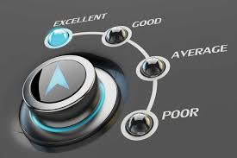
REQUISITE CAPACITY

Slide 3
Definition
Capacity is about delivering results in an organized and consistent manner. However, capacity development is the process of getting better at it.
Earlier one used the term capacity building - but for all of us being here today - it is “developing”. We already have some capacities - but what we seek is more.

Slide 4
Requisite capacity – a balance between the results of the SAI and the core capacity that is needed to achieve these
Capacity is like capital investments – you need to get it right. This means in practice:
The institution and individuals need the right amount of capacity “fit for purpose”
Recurrent costs – i.e. salaries, up-date of technology
Continued development
Apart from having required capacity – the knowledge of what capacity we don’t have and how to compensate for that.
Change approach so no longer needed (accounting, security, communication, event management etc)
Partner your way out – so you have access to capacity
Purchase Capacity

Slide 5
Requisite capacity – a balance between the results of the SAI and the core capacity that is needed to achieve these
Actively seek to get the mix right and accept that changing circumstances means changing capacity mix – develop it in-house or access it through others.

Slide 6
INTERNATIONAL ORGANIZATION OF SUPREME AUDIT INSTITUTIONS (INTOSAI)
STRATEGIC PLAN 2017-2022
INDEPENDENCE ★ INTEGRITY ★ PROFESSIONALISM ★ CREDIBILITY ★ INCLUSIVENESS ★ COOPERATION ★ INNOVATION

Slide 7
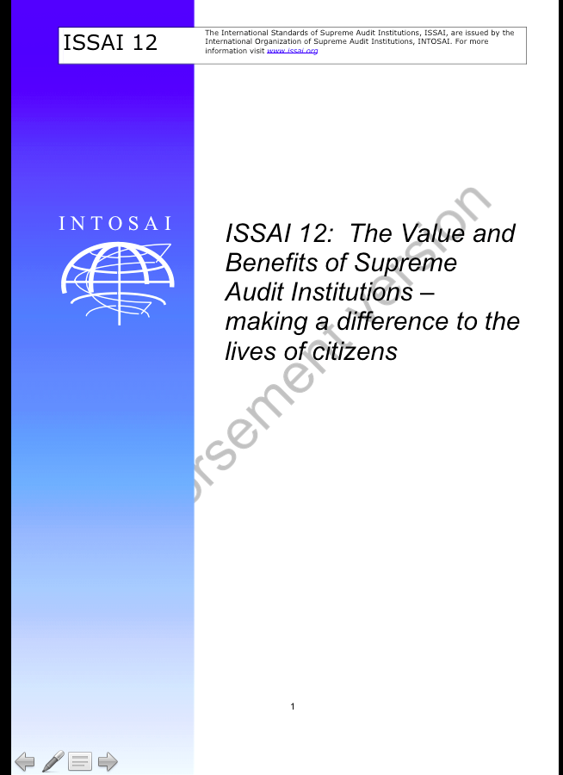
https://www.dropbox.com/s/5ije76qunsl6hkk/Screenshot%202018-08-26%2011.36.27.png?dl=0

Slide 8
Human Resource Management
A Guide for Supreme Audit Institutions

Slide 9
Good Practices in Supporting Supreme
Audit Institutions

Slide 10
Link Capacity Development needs with Capacity Development Opportunity
Capacity needs are many
Capacity opportunities are derived from:
The SAI believe this is important
The partner has the competency to help – technical and/or functional capacity
Somebody is willing to finance
The SAI and the partner has the will and capacity to convert joint action into permanent positive change
Only then there is an Capacity Development opportunity....

Slide 11
Core Capacity Development Levels
Enabling Environment
Institutional
Legislative
Organizational
Budget
Effective management
Individual
Professional knowledge
Ability to act

Slide 12
Double Diamond design process
An archetypical design process that explains its practice and value
PROBLEM
PROBLEM DEFINITION
SOLUTION
DISCOVER
the nature of the problem
DEFINE
the area to focus upon
DEVELOP
potential solutions & entry point
PROJECTIZE SOLUTION
solutions that work
Adapted from NESTA Innovation Playbook / Design Council (2015)

Slide 15
Goal 17 on Partners & Capacity Development
Enhance international support for implementing effective and targeted capacity-building in developing countries to support national plans to implement all the sustainable development goals, including through North-South, South-South and triangular cooperation
Enhance the global partnership for sustainable development, complemented by multi-stakeholder partnerships that mobilize and share knowledge, expertise, technology and financial resources, to support the achievement of the sustainable development goals in all countries, in particular developing countries

Slide 16
SDG Target 17.9
Enhance international support for implementing effective and targeted capacity-building in developing countries to support national plans to implement all the sustainable development goals, including through North-South, South-South and triangular cooperation
Indicator 17.9.1
Dollar value of financial and technical assistance (including through North-South
South-South
Triangular cooperation) committed to developing countries

Slide 18
Cyber Security and Artificial Intelligence
Are these relevant?
What is the scope for SAIs?
What capacities do SAIs need?
Where can SAIs partner to enhance own capacity?

Slide 19
IN CONCLUSION
FOCUS ON OPPORTUNITY & CONTEXT
PROJECTIZE PARTNER SUPPORTED INTERVENTIONS
SCALE THROUGH PORTFOLIO AND BUILD A PIPELINE FOR PROACTIVE NEGOTIATIONS OF FUTURE COLLABORATION

Slide 20
PROBLEM
PROBLEM DEFINITION
SOLUTION
DISCOVER
the nature of the problem
DEFINE
the area to focus upon
DEVELOP
potential solutions & entry point
PROJECTIZE SOLUTION
solutions that work
Enabling Environment
Institutional
Legislative
Organizational
Budget
Effective management
Individual
Professional knowledge
Ability to act
ENTRY POINTS

Slide 21
Q and A slides

Slide 22
Goal 17 on Partners & Capacity Development
By 2020, enhance capacity-building support to developing countries, including for least developed countries and small island developing States, to increase significantly the availability of high-quality, timely and reliable data disaggregated by income, gender, age, race, ethnicity, migratory status, disability, geographic location and other characteristics relevant in national contexts
By 2030, build on existing initiatives to develop measurements of progress on sustainable development that complement gross domestic product, and support statistical capacity-building in developing countries

Slide 23
SDG Target 17.9
Enhance international support for implementing effective and targeted capacity-building in developing countries to support national plans to implement all the sustainable development goals, including through North-South, South-South and triangular cooperation
Indicator 17.9.1
Dollar value of financial and technical assistance (including through North-South
South-South
Triangular cooperation) committed to developing countries

Slide 25
When Capacity Building Need meets with Opportunity
Capacity development is not only a conversation about needs - it is as much about opportunity.
In the absence of an enabling environment and an organization that is well organized - can any results really be achieved. Here I think many of us may have seen results still produced. The reason is often what I call “heroic management”. It is quite possible for a leader and a small group of people to produce good results even within weak institutions - however, it is not sustainable.
Therefore capacity development is particularly effective - when it supports a strong internal drive to deliver, make things right and heroic managers get the job done - while capacity is being build. This also requires flexibility on the part of those who provide the capacity development support and those who pay for it.

