Slide 1
Putting our people first Kimi Makwetu Chair: INTOSAI CBC

Slide 2
Introduction
Lima Declaration, ISSAI 12, SAI PMF all provide guidance on the fundamental importance of HRM
SAI SA experience: Effective HRM is not enough – strive for alignment between employee ambitions and SAI’s strategic objectives

Slide 3
INTOSAI’s inverted pyramid
Supreme Audit Institutions
Regional organisations
INTOSAI global bodies
SAI staff members

Slide 4
Global SAI Stocktaking Report 2017
Globally only 36% of SAIs reported increase in real terms in budgets for professional development
In regions where staff development should be a priority, very few SAIs had increased their budgets for professional development
Many SAIs still do not have training plans, particularly in the case of SAIs with the most stringent budgets for development
Training & transfer of knowledge – just 38% of SAIs use trained staff to run formal internal training courses.

Slide 5
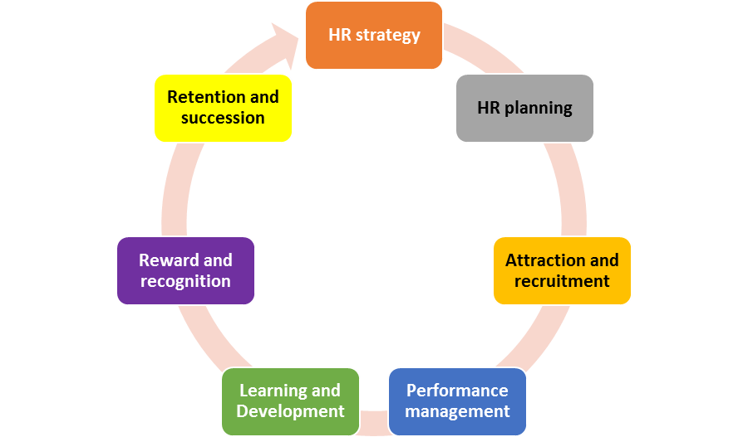
The HR value-chain

Slide 6
SAI PMF questions about HR strategy
Is it aligned with SAI’s strategy and performance objectives?
Does it cover the basic process such as recruitment, retention, remuneration, performance appraisal and professional development?
Does it contain considerations about the number and type of staff required for the strategic planning period?
Has indicators, baselines and targets (e.g. staff turnover, vacancies, non-productive time, etc.) been identified and used?
Is the strategy regularly reviewed and updated, at a minimum once every five years?

Slide 7
Other considerations
Leadership development and the sustainability of good leadership
HR management primarily serving the interests of external stakeholders
Knowing what it is that differentiates you as an employer – what is it that your people value most.

