Slide 1
ISSAI compliance and the future
Bob Creswell
Chief Financial Management Officer, IFAD
Jacek Jezierski Advisor to the President of the Supreme Audit Office of Poland (NIK)
INTOSAI Capacity Building Committee
2 July, 2019
Tokyo, Japan
Notes:
This is the view from IFAD and Poland SAI as to what are the audit challenges and possible solutions
The donor perspective and the SAI perspective have a lot of alignment

Slide 2
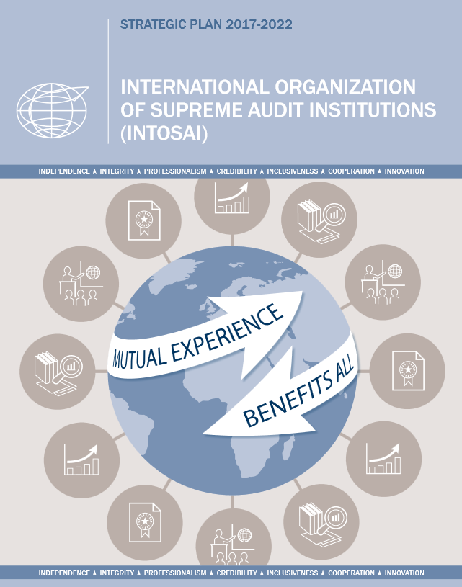
Professional Standards as the Main Driver of INTOSAI’s Activity
INTOSAI Strategic goals
2011 – 2016:
Strategic goal 1: Professional standards
2017 – 2022:
Strategic goal 1: Professional standards
Notes:
strategic goal
standards are the main driver of international co-operation between SAIs
leadership
INTOSAI has set up a strong structure dealing with the issue: PSC, CBC, IDI

Slide 3
Framework of INTOSAI’s Professional Standards
Notes:
Due diligence in standard setting and review
proceedings are established to ensure the standards are up-date and relevant (and successful establishment of the FIPP, the Forum for INTOSAI Professional Pronouncements)
Reform in standards framework
the reform is undergoing to make it more user-friendly and clear
Tools
a number of tools have been made available such a guides and measurement instruments such as SAI PMF, iCAT, and using the ISSAIs in peer reviews
Monitoring
INTOSAI has started to monitor ISSAI compliance at a global and regional level through the Stocktaking surveys of 2014 and 2017 -> CBC Guide 2012: “Implementing the ISSAIs – strategic considerations”

Slide 4
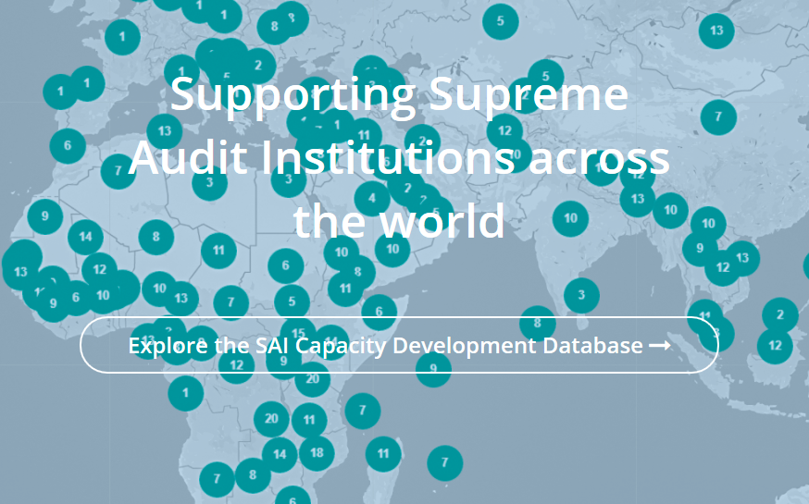
INTOSAI – Donors cooperation
Notes:
Co-operation with donors The long history of co-operation with donors, a number of capacity building projects which are based on ISSAI implementation

Slide 5
The Global Context
Notes:
Loss of confidence in our financial and business systems:
LIBOR
Volkswagen
Carillion
Loss of confidence in many political leaders as expressed by protest votes
Loss of confidence in private sector auditors:
UK Business Energy and industrial Strategy Committee (BEISC) conducting an inquiry into the future of audit recommended (Apr 2019) the Competition And Markets Authority split Big Four into audit and non-audit: audit in UK is broken due to lack of competition results in conflicts of interest
27% of Big Four audits reviewed for 2017/18 did not meet the UK FRC quality standards
India is considering banning certain high profile audit firms for non-performance
Trust is a pre-requisite for investment and economic growth

Slide 6
Audit Expectation Gap
Notes:
Public perception now goes beyond legal minimum requirement, especially concerning detection of fraud. The recent press concerning the Big Four shows times are changing.
With no commercial pressure, expectations are higher for public sector auditors!
No obligation to use international standards so if claim to adopt them then the public would expect all the standards to be followed. Two main issues:
a/. National over-ride: ISSAI 100 defines the authority of the ISSAIs and defines how an auditor can claim ISSAI compliance in an audit report: the principles in no way override national laws, regulations or mandates
b/. Are they being followed? Refer to the delivery gap on the next slide

Slide 7
Audit Delivery Gap
Notes:
NB (re-)building trust isn’t the whole issue – the underlying substance has to be there first
Principles listed in ISSAI 12 Value and Benefits – don’t compromise quality, lead by example
Standards drive consistency – need to have confidence to rely on them
Quality Assurance checks are required to ensure standards are followed
IDI Global State of SAIs 2017 – see next slide

Slide 8
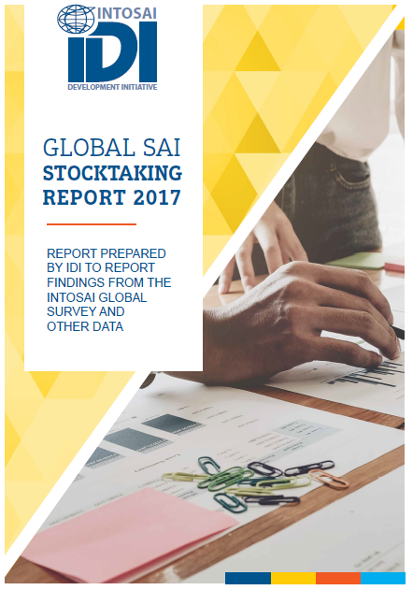
Examples of Delivery Issues
Many SAIs report they are adopting the ISSAIs
Most SAIs do not yet have ISSAI compliant standards
Few SAIs have fully implemented the ISSAIs
SAIs need better QC & QA systems to measure and strengthen their audit quality
Notes:
Is there an issue? Do most auditors do a professional quality job consistently? IDI’s report suggests that it is a key problem and opportunity for improvement
IDI highlight the need for greater compliance with stated ISSAI standards and the need for continuous quality monitoring

Slide 9
Examples of Delivery Issues Noted by IFAD
Difference in format of audit opinion (ISSAI 1700)
Audited Financial Statements not fully compliant with the financial reporting standards claimed e.g. IPSAS
Lack of clarity over the accounting policy adopted
Lack of implementation status of prior recommendations
Rarely see the optional Key Audit Matters ISSAI 1701
Too much focus on immaterial issues of a compliance nature
Notes:
8.44. The auditor’s report should include the following elements as per ISSAI 1700.20 to ISSAI 1700.49:
Form and content of auditor’s report on financial statements
● Title
● Addressee
● Auditor’s Opinion
● Basis for Opinion
● Going Concern (If applicable)
● Key Audit Matters (only when relevant and applicable)

Slide 10
What Stands Behind?
What does full compliance with ISSAIs mean?
Differences between SAIs
Type of audit model
Mandate
National legislative basis on which an SAI functions
Which standards are not followed?
What deviations are introduced?
Is a deviation acceptable? In what circumstances?
What independent and objective measure prove that an SAI complies with ISSAIs?
Tools: SAI PMF, iCAT, peer reviews
Peer-to-peer support
Notes:
The reasons for deviation in implementing ISSAIs
Type of audit
Mandate
National legislative basis on which an SAI functions
Which standards are not followed? In which a deviation is introduced?
Is a deviation acceptable? In what circumstances?
If there is deviation, or partial compliance, how to disclose this in the public reports without running the risk of being criticized by the Parliament or other key stakeholders

Slide 11
Implementation Pitfalls
Lack of clarity and insufficient communication
Need for improvement feedback loops
Support for interpretation
Lack of buy-in of SAIs
Not a priority for SAI leaders
Lack of skills and resources at developing SAIs vs. need to develop a critical mass of professional auditors
Development consultants are not training in line with ISSAIs
Gaps regarding QC and QA systems
Notes:
What independent and objective measure prove that an SAI complies with ISSAIs?
Tools – SAI PMF, iCAT, peer reviews.
Peer-to-peer support -> possible because of co-financing with donors
What more?
Other
lack of clarity and not sufficient communication
need for improvement feedback loops
support for interpretation
lack of buy-in/ lack of priority for SAI leaders
lack of skills and resources at developing SAIs vs need to develop a critical mass of professional auditors
development consultants are not training in line with ISSAIs
gaps regarding QC and QA systems

Slide 12
INTOSAI: Solutions
INTOSAI’s plans
What is needed ?
Ongoing:
Reform of standards framework
Improvements in communication
Pending:
Improved feedback loop
Technical support function under the PSC
Support for translations
IDI PESA programme
Global stocktaking survey in future to provide better data for better analysis
Strong leadership
Commitment of SAIs leaders
Convincing SAIs’ staff to go beyond national regulations
Resources
More INTOSAI – Donor cooperation
Notes:
Improvements in communication (awareness campaign, successful regional programmes to be replicated -> CBC Regional Forum, sharing good practices -> CBC website, INTOSAI community portal)
Strong leadership
Committment of SAIs leaders -> Special programme for SAI leaders
SAIs’ staff – to go beyond national regulations
Lack of resources –> donors
INTOSAI – Donor co-operation
Actually a re-commitment of SAIs leaders because at XX INCOSAI in 2010, all SAIs had committed to implement the ISSAIs

Slide 13
Solutions to the Expectation Gap
Notes:
We need to speak the same understandable language and communicate transparently and publicly what assurance is and isn’t being provided
Publicise audit reports – for IFAD this is now mandatory
Encourage use of social media
Publicise QA compliance
Highlight gaps to international standards and explain e.g. for national system over-rides
Key audit matters – optional but of public interest : ISSAI 1701 “Communicating Key Audit Matters in the Independent’s auditor’s report .
required to communicate KAM in an audit of listed companies and can apply voluntarily to audit entities other than listed entities. As stated in Paragraph 3 of PN of ISSAI 1701, “Given that the public sector is a significant participant of any economy and is responsible for maintaining and providing important functions that affect citizens, public sector auditors should also consider reporting KAM for auditees other than listed entities.”

Slide 14
Solutions to the Expectation Gap
ISSAI Measures
Non-ISSAI Measures
ISSAI 100 national over-ride:
Solution 1 – if ‘ISSAI compliant’, then can we do without the national over-ride
Solution 2 - if a particular standard is not followed, deviations could be explained
Increase audit coverage through technology, identify more issues / opportunities on value for money
Going concern, e.g. failure just after clean opinion - comment on the adequacy of working capital for State Owned Enterprises of a commercial nature
Could more unaudited explanatory information be included within audit scope (agreed upon procedures) without distracting from the core purpose given limited SAI resources?
Be more specific about fraud / corruption assurance
Can we better highlight the work done by audit internationally?
Notes:
Many demands on SAI resources: SDGs, environmental, VFM so don’t get distracted from auditing the FS!

Slide 15
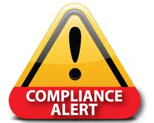
Solutions to the Delivery Gap
Greater emphasis on and call for quality and professionalism as a means of achieving compliance
Strong leadership
Capacity building
Peer review and other assessment tools
Can INTOSAI move to be an organisation with greater power to ensure compliance?
Encourage auditors to go beyond compliance with national laws
Proposed “INTOSAI Framework of Professional Pronouncements (IFPP)” Sept 2019, is designed to clarify what SAIs need to do to claim ISSAI compliance
Notes:
Can we get greater Value For Money
Why don’t more audits identify fraud and corruption?

Slide 16
IFAD: Points for Further Discussion
How can INTOSAI as a voluntary organisation without enforcement ensure compliance?
Might an IIA External Quality Assessment style (every 5 years) play a role?
What does “adoption” of ISSAIs imply given differences with national laws?
Can ISSAIs be adopted as the national laws so they have a legal basis?
How can IFPP (INCOSAI Sept 2019) be leveraged to enhance professional capacities in-country?
If we don’t step forward and remain relevant we have both a reputational and an operational risk
Notes:
Can we get greater Value For Money
Why don’t more audits identify fraud and corruption?
ISSAIs areb principles-based whilst national audit laws are rules-based

Slide 17
Thank you!
Contact details:
Bob Creswell: r.creswell@ifad.org
Jacek Jezierski: Jacek.Jezierski@nik.gov.pl

