Slide 1
With a little help from our friends – peer review benefits, challenges and lessons learned
10 November 2021
Presentation by
Daniel Tibor

Slide 2
Our lessons learned
A peer review is not an audit!
Have a clear idea about your motivation!
Define well: the subject(s) of the peer review!
Choose carefully: the friends you wish to invite to the party!
The main benefit of the peer review is the peer review!

Slide 3
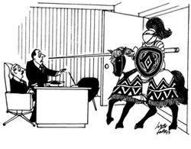
A peer review is not an audit!

Slide 4
Our motivation
An independent mid-term review
assessing the progress made in implementing
our strategy for the period 2018-2020.

Slide 5
The subjects
Overall strategic approach;
Improve the added value of the Statement of Assurance (SoA) in the context of today’s EU financial management (Goal 1);
Increased focus on the performance aspects of EU action (Goal 2); and
Get clear messages across to the ECA’s audience (Goal 3).

Slide 6
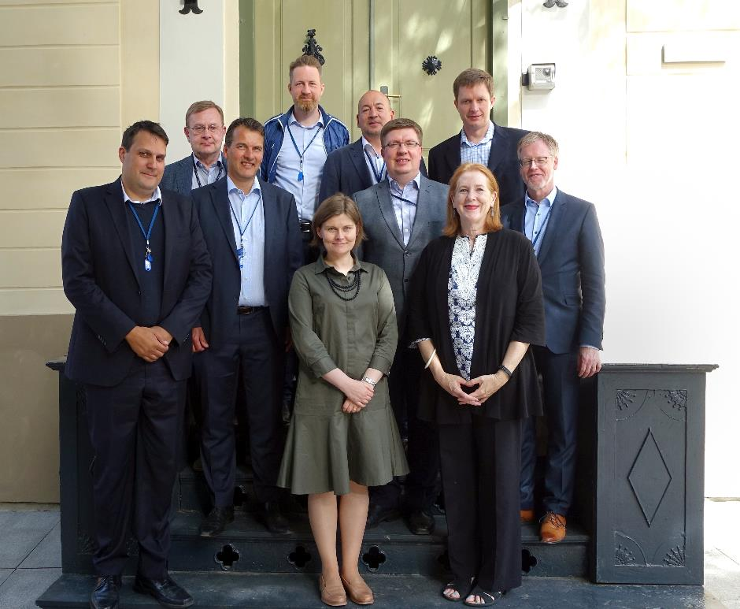
Our friends

Slide 7
The benefit of the peer review
Requests 1, 2, …
Publication
Visits 1, 2, …
Kick-off meeting
Meetings
Meetings
MoU
Clear facts
Collect, consolidate and prepare relevant info for peers
Final Report
Identify friends
Additional requests
Identify subject
Exchange on preliminary findings and recommendations
Motivation

Slide 8
Contact details
Daniel Tibor
Senior Institutional relations officer
Corporate strategy, planning and performance management, Communication and media relations, Institutional liaison
daniel.tibor@eca.europa.eu
Want to know more about our work:
Visit our website: eca.europa.eu
Follow us on Twitter @EUAuditors
Check our page on LinkedIn and Facebook
Watch our videos on YouTube: EUAuditorsECA
Contact us at: ECA-info@eca.europa.eu

