Slide 1
Welcome to the CBC Steering Committee’s on-line meeting 2022

Slide 2
Agenda
Welcome – including approval of agenda
Overview of pre-approved documents
New documents for approval
Brief reports on key issues/ developments
CBC at XXIV INCOSAI:
Documents to be endorsed by GB and/or Congress
Information about CBC meeting (Nov 8th), the CBC booth and side event
Group discussions on two strategic questions arising from the Goal 2 Operational Plan
Changes in workstream leaders
Date, venue and format for 2023 meeting
Any other business
Closing

Slide 3
1. Welcome – including approval of the agenda
The steering committee is asked to approve the agenda

Slide 4
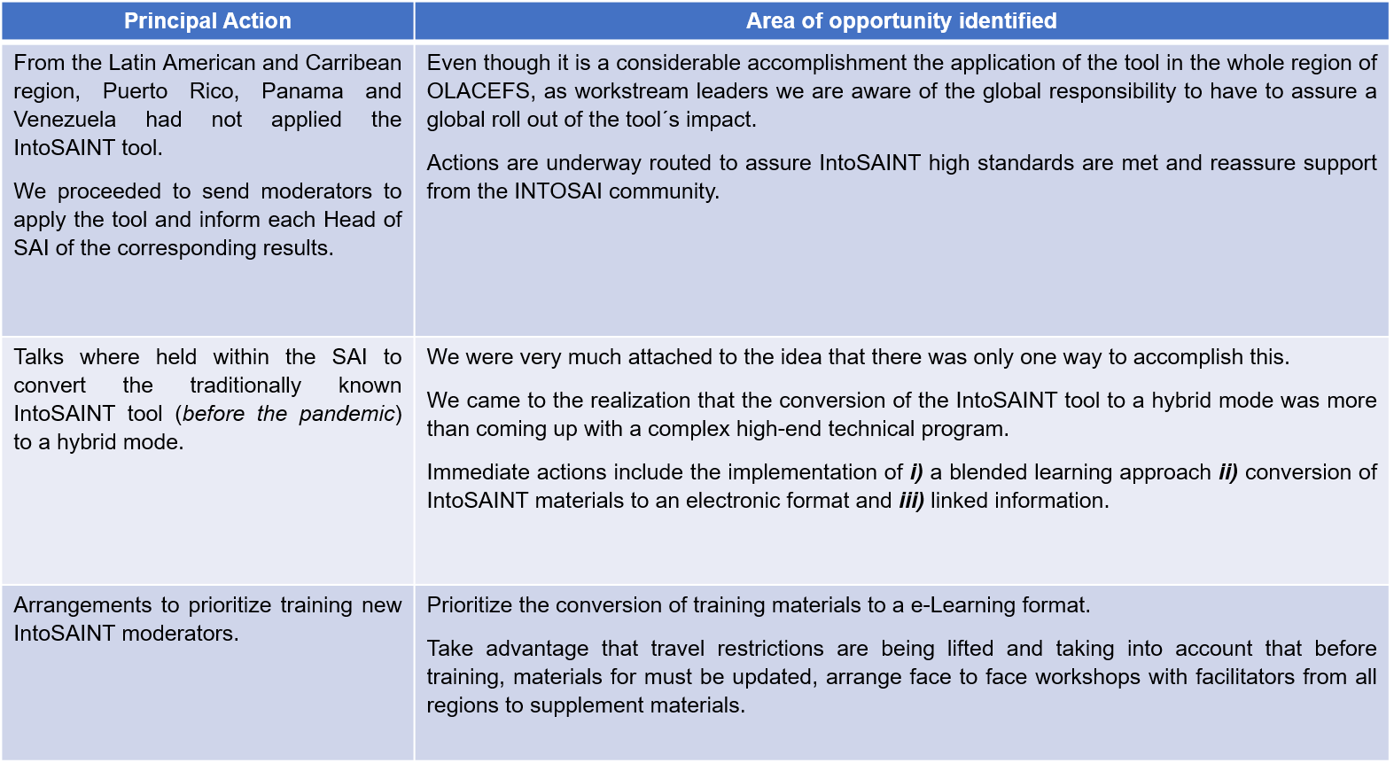
2. Pre-approved documents
IntoSAINT

Slide 5
2. Overview of pre-approved reports
For the minutes, the steering committee is asked to please note the approval of:
The draft minutes from the 2021 steering committee meeting
Dashboard reports from the workstreams – including approval of the report from IntoSAINT
SAI PMF implementation progress report and SAI PMF implementation strategy 2023-28
The proposed CBC budget setting out the allocation of funds received from INTOSAI for use over the next 12 months
Revised CBC Terms of Reference

Slide 6
3a. New documents for approval
The steering committee is asked to approve:
CBC Motion on Sustainable INTOSAI Operations

Slide 7
3a. Goal 2 Strategic Objectives
2.1 Promote, facilitate and implement INTOSAI-wide initiatives in support of SAI capacity development needs.
2.2 Strategically partner, inside and outside INTOSAI, in support of SAI professionalism, auditor professionalization, and SAIs’ ability to sustainably meet future challenges.
2.3 Share capacity development insights and practices, and facilitate dialogue on capacity development challenges and opportunities.

Slide 8
3a. New documents for approval
The steering committee is asked to approve:
CBC Motion on Sustainable INTOSAI Operations
The Objectives for Goal 2 in the new INTOSAI Strategic Plan
The Goal 2 Operational Plan

Slide 9
3b. Brief reports on key issues/ developments

Slide 10
SAI PMF INDEPENDENT ADVISORY GROUP
Insights prepared for Capacity Building Committee
20 September 2022

Slide 11
AREAS DISCUSSED BY IAG
Publication of SAI PMF results
Suggestions for future revision of SAI PMF tool
SAI PMF in high-income countries
Promotion of SAI PMF
External evaluators recommendation to IAG

Slide 12
3b. Brief reports on key issues/ developments
The steering committee is asked to take note of:
the insights from the SAI PMF Independent Advisory Group – to be considered by the CBC Secretariat, in consultation with the IDI
The steering committee is encouraged to support the establishment of the new workstream for on Citizen Participation in Audit under the leadership of SAI Peru

Slide 13
4a. INCOSAI Endorsements
Report on Goal 2 activities
Goal 2 Operational Plan
Motion on Sustainable INTOSAI Operations
ISSAI 150 Auditor competence
GUID 1950 Guidance on the development of competency frameworks for auditors
GUID 1951 Guidance on the development of pathways for professional development of auditors
Revised CBC Guide on Human Resource Management
Revised CBC Terms of Reference
Terms of Reference of the new workstream on Citizen Participation

Slide 14
4. CBC at XXIV INCOSAI
(a) Documents to be endorsed by GB and/or Congress
(b) Information about CBC meeting (Nov 8th), the CBC booth and side event
The steering committee is asked to take note of the report

Slide 15
Comfort break 5 minutes
Please follow @INTOSAI_CBC
for more updates

Slide 16
5. Group discussions on two strategic questions arising from Goal 2 Operational Plan
Discussion questions:
What could be the 3–4 key success factors for the Goal 2 “family” to effectively implement the Goal 2 Operational Plan and thereby sustainably support SAI capacity development?
Are there any significant “challenges or opportunities” not highlighted in the Goal 2 Operational Plan?

Slide 17
6. Changes in workstream leaders
The steering committee is asked to –
Approve the proposal to change the process of reviewing or updating guides, under the management of the CBC secretariat
Approve the proposed co-chairmanship for the workstream on peer-to-peer cooperation

Slide 18
7. Date, venue and format for the 2023 meeting
The steering committee is asked to take note of SAI Jamaica as the host for an in-person meeting (with on-line options to be determined) in May/June for next year’s meeting.

Slide 19
8. Any other business

Slide 20
9. Closing of the meeting
Thank you! All documents will be published on: www.intosaicbc.org

