Slide 1
The capacity of regional organisations as a key success factor for
SAI development
CBC Annual Meeting – Jamaica
June 2023

Slide 2
3 key challenges in
capacity development
by CCC/Olacefs
coordination
governance
professionalisation alignment

Slide 3
How to coordinate efforts for capacity building in the region considering different realities, cultures or languages?
1

Slide 4
How have we faced this challenge?
common processes
common platform
common themes and offers

Slide 5
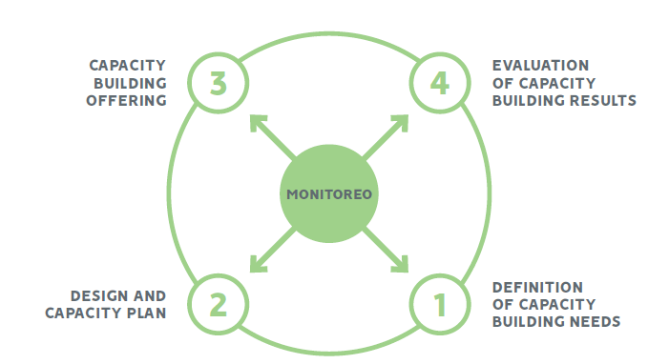
Capacity Building Process
MONITORING
ISO 10015 training cycle

Slide 6
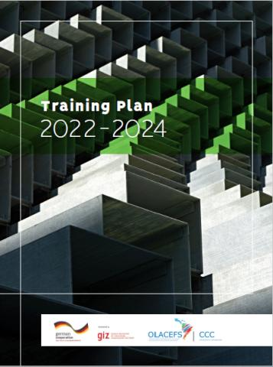
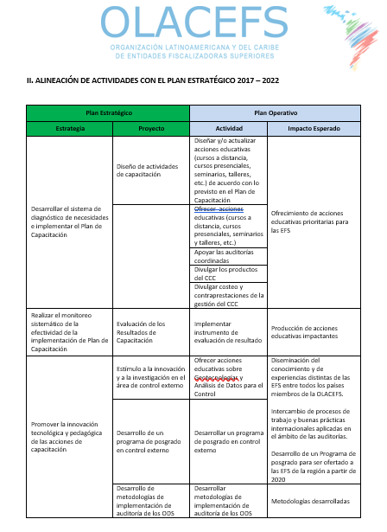
Common Planning
Diagnosis and
training needs
Capacity Building
Plan - 3 years
Annual Operating
Plan (POA) – 1 year
1
COMPETENCIES
116 mapped
38
prioritized
2
THEMATIC GROUPS
external control processes
technology and innovation
control areas

Slide 7
Common Platform
Educational Management System

Slide 8
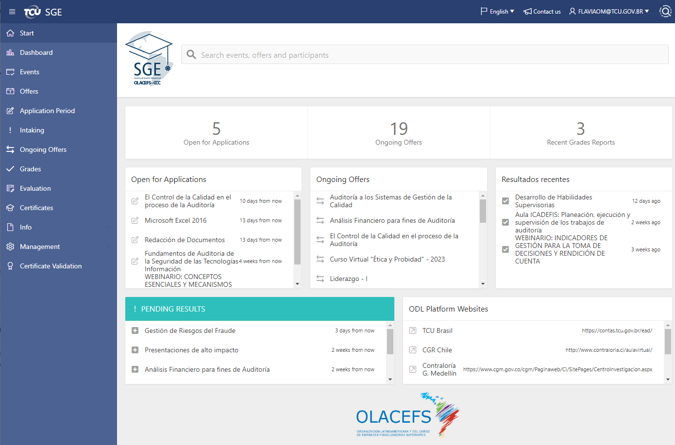

Slide 9
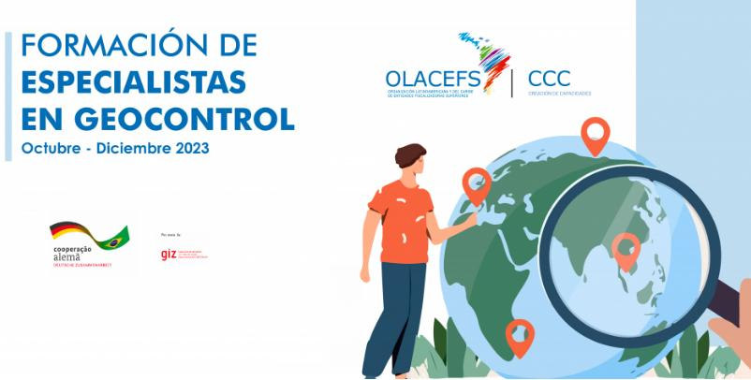
Common themes and offers
Training and mentoring with partner funding (GIZ/German cooperation)

Slide 10
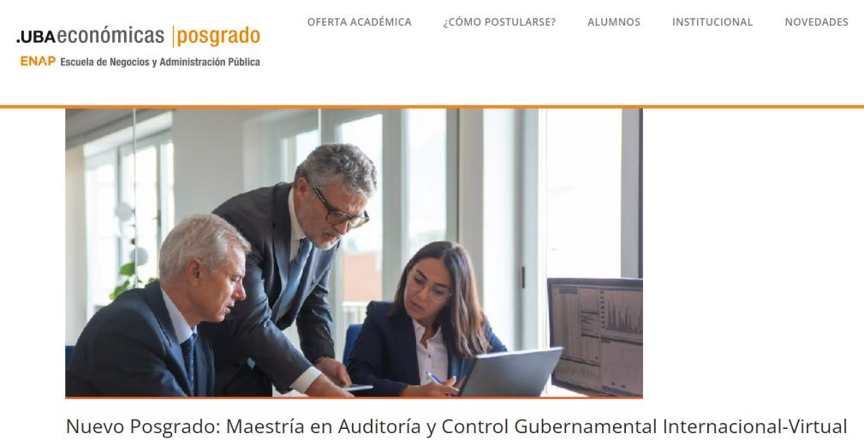
Common themes and offers
Postgraduate with academic partnership (University of Buenos Aires, Argentina - UBA)

Slide 11
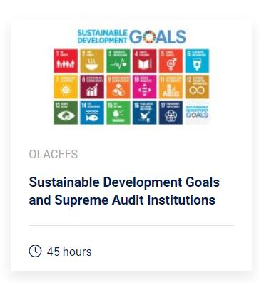
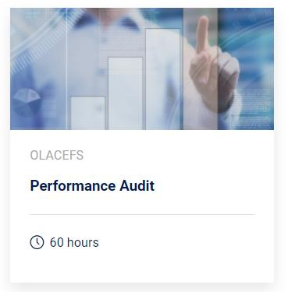
Common themes and offers
Massive Open Online Courses (MOOCs)

Slide 12
How to share responsibilities and ensure member engagement and good governance in the region?
2

Slide 13
How have we faced this challenge?
tasks forces
partnerships
Map out the main capacity development and management processes and assign responsibility for each to members for a period

Slide 14
1 año
Fuerza de tarea
CCC Governance
2 years
Work
process
responsibility
Renewable
+2 years
Work
process
responsibility
1 year
Task
force

Slide 15
How to ensure principle-based professionalization of auditors
strengthening the global voice of the Intosai?
3

Slide 16
How have we faced this challenge?
education programs and certifications based on good practices and standards

Slide 17
Professional certification
https://www.idi.no/es/work-streams/professional-sais/pesa-p/what-is-pesa-p

Slide 18
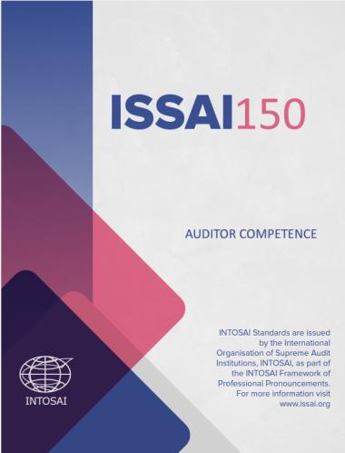
Professional trajectories based on ISSAI 150

Slide 19
Adriano Amorim
Director-General
Serzedello Corrêa Institute (ISC)
Federal Court of Accounts – Brazil (TCU)
Paula Hebling
Head of the International Relations Department
Federal Court of Accounts – Brazil (TCU)
dutraph@tcu.gov.br
adrianocf@tcu.gov.br

