Slide 1
QUALITY PEOPLE

Slide 2
www.menti.com
Code: 3480 2946

Slide 4
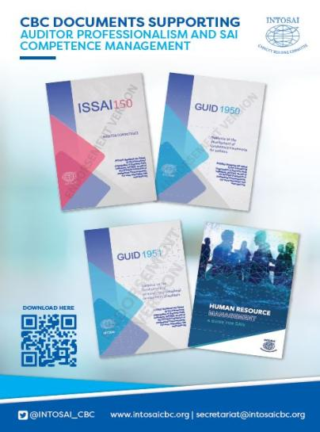
Professional pronouncements on auditor competence

Slide 5
ISSAI 150 unpacked
Requirement | Guidance
1. A SAI shall determine and document relevant competencies required for all auditors to fulfil the SAI mandate. | GUID 1950 Future-relevant, value-adding auditor guide
2. A SAI shall have appropriate human resource management processes and practices to ensure that its auditors have the relevant competencies determined by the SAI. | Human resource management guide
3. A SAI shall establish dedicated pathways for professional development of auditors, specifically tailored to the SAI’s mandate, regulatory framework, organisation structure and needs. | GUID 1951
4. A SAI shall develop and implement the means for assessment of competencies and following up of auditor development progression or self-development on a periodic basis. | GUID 1950

Slide 6
ISSAI 150 in action

Slide 7
2020 Global Stock-take Report

Slide 8
2020 Global Stock-take Report
30% of SAIs responded that professional development programs are recognized and regulated by a national educational / professional regulatory body responsible for the quality of educational / professional programmes

Slide 9
2020 Global Stock-take Report
65% | of SAIs globally report that they have developed a competency framework across all three audit streams;
56% | state that the have built their human resource management processes around their competency framework;
70% | of SAIs have appraisal mechanisms in place (fully or partial) to assess auditor competence and performance against the competency framework

Slide 10
Where to from here?
Using the mentimeter facility per table, discuss and respond to the following –
What are the top challenges that you foresee in the implementation of the 4 requirements of ISSAI 150?
What tools will you require to facilitate the implementation of ISSAI 150?
With whom will you have to set up enabling relationships to make ISSAI 150 implementation a reality?
What do you require to be able to set up these enabling relationships?

