Slide 1
Quality Management in Small and Developing SAIs
INTOSAI CBC Meeting

Slide 2
OUR MEMBERS
Angola, Botswana, Eritrea, Eswatini, Ethiopia, Gambia, Ghana, Kenya, Lesotho, Liberia, Malawi, Mauritius, Mozambique, Namibia, Nigeria, Rwanda, Seychelles, Sierra Leone, Somalia, South Africa, South Sudan, Sudan, Tanzania, Uganda, Zambia, Zimbabwe

Slide 3
Small and Developing SAI’s
Considerations:
SAI’s with less than 100 auditors
Percentage of SAI auditors to the country’s population
Mandated audits in relation to SAI auditors
As per DAC criteria
Notes:
SAIs auditors with less than 100 auditors: 6
Mandated audits in relation to SAI auditors: 4
WB DAC list: 22

Slide 4
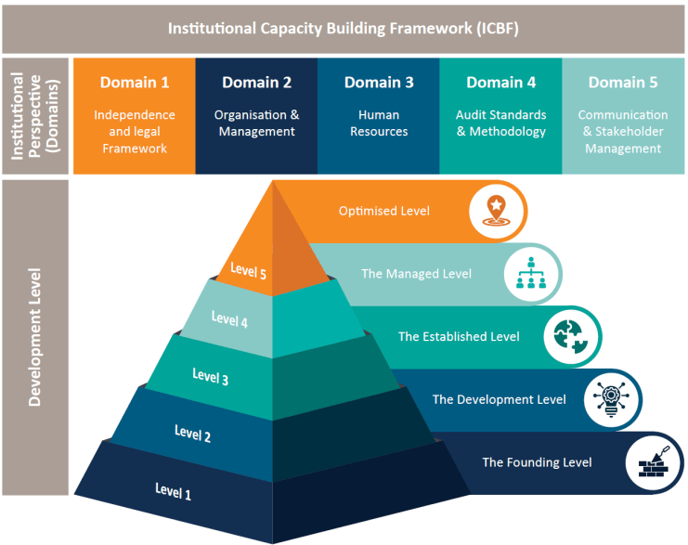
ICBF Levels of Development
Notes:
Link the ICBF to SAI PMF
GB resolution
Criteria level

Slide 5
ICBF Self-Assessment Results
Audit Standards & Quality Management vs Audit Engagement Process
Notes:
Smallest SAIs with 26 auditors
Audit engagement and QM
Vs 6 Small SAI’s

Slide 6
QARS
SAI SUPPORT PLANS
ICBF
SAI Action Plans
Notes:
What does a typical quality review include:
Institutional review – 5 ICBF domains
Review of audit files
Financial
Compliance
Performance
IT
QA review report compiled by the AFROSAI-E team
Action Plan compiled by SAI
AFROSAI-E follow-up on areas agreed with SAI

Slide 7
Successes
Certified quality assurance reviewers
Adoption and implementation of a financial reporting framework
More SAIs are auditing critical information systems
SAIs implementing customised audit manuals
Increased audit coverage
SAI’s strategic plans developed and implemented
ICBF self-assessment
Internal quality management function

Slide 8
Challenges
Financial & administrative independence constraints
Establishment of standalone quality assurance unit
Lack of:
- Supervision and review at senior management level
- Actions to address identified findings and gaps
- Performance management systems
Below average competency of auditors' skills sets
Notes:
Constraints on the financial and administrative independence of the SAIs, impacting their ability to effectively deliver quality audit services
Lack or inadequacy of various governance systems and frameworks for quality management, risk management, monitoring and evaluation, and integrity and ethics
Most SAIs have audit manuals that address quality assurance at the audit level; however, supervision and review remain a challenge, especially at senior management level
Root cause for lack of:
Tone at the top
Lack of consequence management

Slide 9
Challenges
Available staff resources vs number of audits to be completed and audit timeliness
High staff turnover
Inadequate governance systems & frameworks

Slide 10
Approaches to address challenges
Positive advocacy approach to SAI independence
Professionalisation of the SAI and staff
Sustainable Capacity-building initiatives
Tone at the top and quality-focused culture
Strengthening of robust quality management systems
Internal quality assurance reviews performed by certified quality assurance reviewers on an annual basis and annual report produced
AFROSAI-E SAI Enhancement Audit Tool (A-SEAT) to enable efficient reviews and remote product reviews by AFROSAI-E
Notes:
ToT
QA Certification
Senior management

