Slide 1
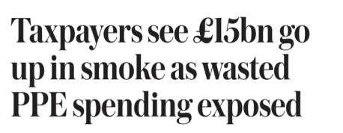
Audit Impact – a UK view

Slide 2
Our Strategic Priorities:
Our work:
Improving our support for effective accountability and scrutiny
PAC held 69 evidence sessions based on our work
We certified over 400 accounts auditing £1.8 trillion of public income and expenditure
Providing more accessible independent insight
We published 63 major outputs and 10
overviews of departments
1,169
Responses to letters from the public and MPs
Increasing our impact on outcomes and value for money

Slide 3
Measuring progress against our strategic priorities
Strategic priority
What success looks like
How we measure this
Target for 23-24
Target for 24-25
Why we chose these measures
We support effective accountability and scrutiny
Successful delivery of our programme of financial audit, value-for-money and wider work programme
Number of financial audits, value for-money (VfM) reports and wider assurance work
60 to 65 VfM reports and around 400 audit certifications each year
60 to 65 VfM reports and around 400 audit certifications each year
The platform for supporting Parliament is the delivery of our core work (the VFM reports and Financial Audit certifications)
The quality of our audits is in step with the best of the profession and meets external quality standards
All of our audits that have been reviewed by the Financial Reporting Council or subject to internal cold review are classified as needing no more than limited improvements
VfM reports subjected to an external cold review meet standards and VfM reports subjected to an internal cold review rated as ‘good with limited improvement needed’ or higher
100% of our financial audit work meets Financial Reporting Council and internal standards
100% of our VfM audit work meets internal standards
100% of our financial audit work meets Financial Reporting Council and internal standard
100% of our VfM audit work meets internal standards
We want to demonstrate that this work is of the highest quality standards (100% compliance)
MPs consider that we support effective accountability and scrutiny
MPs agree that the NAO is effective at supporting Parliament to hold government to account and scrutinise public services
90% of MPs agree
90% of MPs agree
We want MPs to agree that we are effective against this strategic priority

Slide 4
Measuring progress against our strategic priorities
Strategic priority
What success looks like
How we measure this
Target for 23-24
Target for 24-25
Why we chose these measures
We provide accessible independent insight
Our knowledge and insights are clear and accessible to key stakeholders
MPs agree that they can easily access our insights and knowledge
62% of MPs agree
65% of MPs agree
These are new measures to relate specifically to the key stakeholders we want to benefit from us making greater use of our insights, as well as a more generic media measure to understand our public impact
Annually commissioned independent feedback from senior officials shows that they an easily access our insights and knowledge
68% of senior officials agree
70% of senior officials agree
Average article rating – a composite score of media impact – based on profile, inclusion of spokespeople and balance of positive and negative references
62 out of 100
64 out of 100

Slide 5
Measuring progress against our strategic priorities
Strategic priority
What success looks like
How we measure this
Target for 23-24
Target for 24-25
Why we chose these measures
Our work leads to better outcomes and value for money
Our work has a quantifiable positive financial impact on the public sector
Total value of financial impacts generated by our work, as agreed with the audited body, against our final net outturn
£10 financial impact for every £1 of net expenditure each year
£10 financial impact for every £1 of net expenditure each year
The financial impacts measure is the best long-standing quantitative metric we have relating to the impact of our work
Senior officials in the bodies we audit consider that our work leads to better outcomes
Annually commissioned independent feedback from senior officials shows that they agree that our work leads to better outcomes
68% of senior officials agree
70% of senior officials agree
We want senior officials in audited bodies to agree that our work leads to better outcomes

Slide 6
Financial impacts – a long standing measure
What are the criteria for a financial impact?
All financial impacts must meet one of the four categories and all five principles.
Categories
Reduced expenditure where impacts release financial resources that can be diverted to other public sector services.
Revenue increases for the public sector arise when a department generates greater net income.
Public sector improvements occur when productivity or output quality increases for the same or proportionately fewer resources.
Other benefits to third parties embrace consumers, taxpayers and industry more widely. These benefits can be cashable or non-cashable.
Principles
Causation: There must be a causal link between work conducted by the NAO and the benefit.
Realisation: Impacts must have been realised within, or before, the calendar year in which they are reported.
Valuation: Reliable evidence and/or data supports claims and implementation costs are acknowledged. For financial impacts, there is a robust methodology to value the impact, net of implementation costs.
Attribution: The proportion of impact claimed should reflect the NAO's degree of contribution to the benefit realised.
Validation: All impact claims need to be validated by the audited body concerned (at sufficiently senior level) and approved internally by Directors/Executive Leaders.
Validation
Statement of financial impacts included in our Annual Report and Accounts
External auditors are specifically engaged to provide an opinion on this which is included in our Annual Report
They provide assurance that impacts are prepared in line with agreed methodology

Slide 7
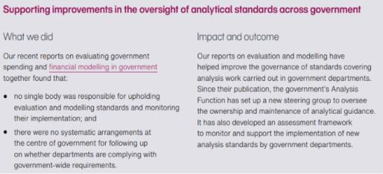
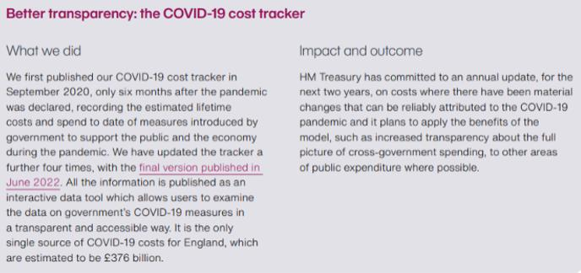
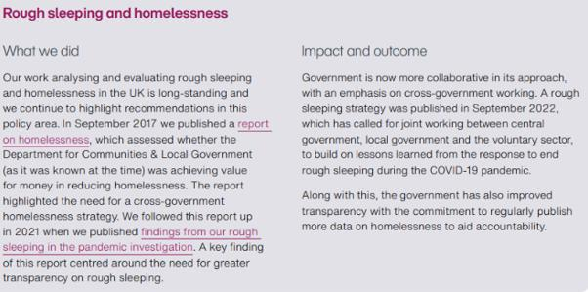
Wider impacts - case studies in our Annual Report

Slide 8
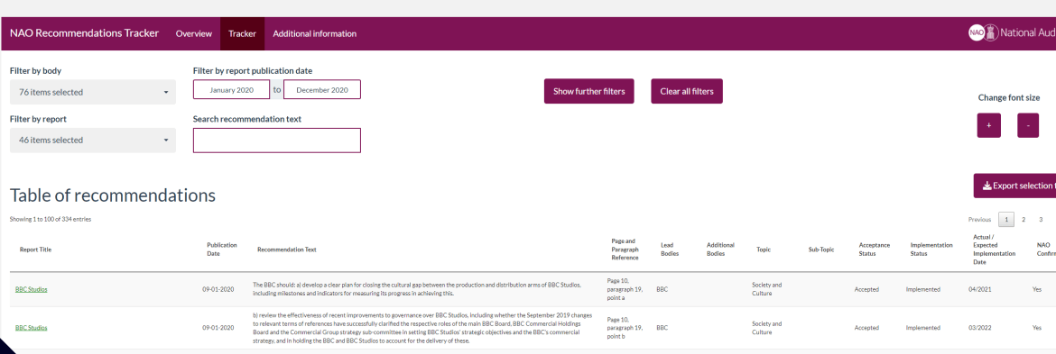
Published recommendation tracker
This tracker brings together NAO recommendations published in our reports since 1 April 2019.
Provides information on whether government has accepted the recommendations, and if so, the progress it has made with implementing the actions specified.
Available on our website for any member of the public: Recommendations tracker - National Audit Office (NAO)
Can be filtered by report subject, date and department

Slide 9
Practical support for PAC
PAC programme
NAO provides Committee with information on forthcoming NAO publications and PAC chooses which to take evidence on
NAO provides advice on witnesses for sessions but Committee’s decision who to call
PAC sessions
NAO briefs Members ahead of all sessions, but Members choose which themes and lines of inquiry they want to focus on.
C&AG and NAO Parliamentary Relations Team attend all sessions and NAO team who prepared report
PAC reports and follow-up
NAO supports PAC on draft report
Government is required to formally respond to the PAC recommendations (unlike NAO recommendations)
NAO provides advice on government’s response to PAC recommendations

Slide 10
Wider support to Parliament (MPs and Peers)
650 MPs received a copy of every NAO report with an offer of a briefing on report
900 MPs and Peers received our fortnightly parliamentary newsletter with updates
58 briefings on our work and areas of expertise to MPs and Peers
84 responses to MPs’ correspondence raising concerns over misuse of public money or behaviour in public bodies

Slide 11
Wider support to Parliament (Select Committees)
26 occasions provided support to committees for sessions and inquiries e.g. - Business, Energy and Industrial strategy committee inquiry into Net Zero and Treasury Committee inquiry into the economic impact of COVID-19
12 bespoke pieces of work for select committees and All-Party Parliamentary Groups, e.g. briefing to support APPG inquiry on Department for Transport’s Cycling and Walking Investment Strategy
8 departmental overviews published on government departments’ accounts and performance, based on insight from both our VFM and financial audit work
10 NAO colleagues seconded to Parliament

Slide 12
In summary
Our strategic objectives shape how we measure impact
A full basket of measures (balanced scorecard)
High quality a foundation for impact
Planning for impact upfront
Use of website to engage public
Focus on Parliament as a key stakeholder

Slide 13
Audit Impact – a UK view
Any Questions?

