Slide 1
What is audit impact?
The contribution of the SAI’s audit work to positive effects on people and planet (a society/on a group/area), especially those left behind or at risk of being left behind

Slide 2
Positive effects of SAI Audits
Deterence
Assurance
Ethical Behaviour
Accountability
Transparency
Inclusiveness
Trust
Effectiveness
National outcomes
Service Delivery
Compliance
Culture change

Slide 3
Financial Audit
Coverage, Reasonable Assurance
Financial statements reflect true & fair view
Performance Audits
Recommendations to improve economy, efficiency & effectiveness in areas of high relevance
Improved economy, efficiency and effectiveness of public institutions
Compliance Audits
Conclusions and recommendations to improve compliance, transparency and accountability of government actions
Improved compliance frameworks and better compliance with laws and regulations
Public confidence in government financial systems
Better societies and Better lives
Culture of transparency, accountability and compliance leading to trust in government

Slide 4
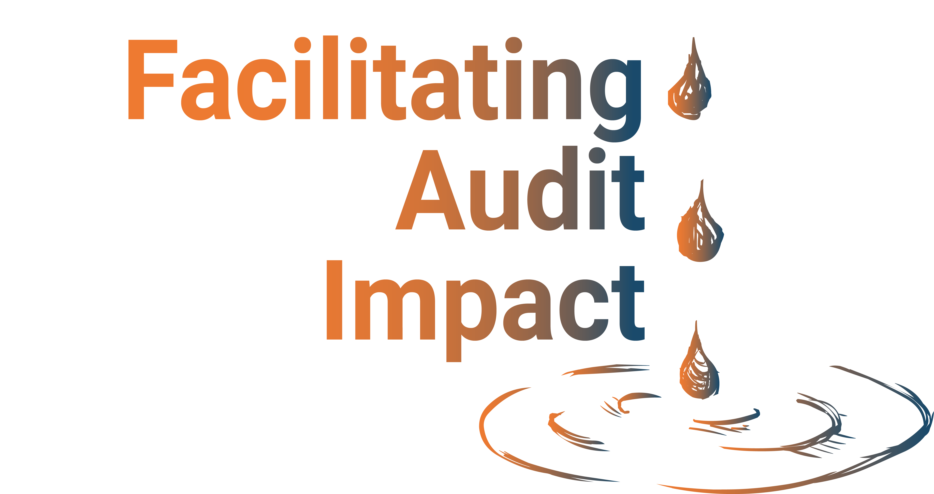
Impact Driven Audits
Strong Stakeholder Coalitions
Robust Follow Up Systems

Slide 5
Use of foresight and futuring techniques
Plan for SAI Audit Impact
Proactive role of SAI Leadership
Sustainable Audit Practices
Competent SAI Audit professionals
System of Audit Quality Management
Use of technology
Build strong stakeholder coalitions
Foster an impact mindset and culture
Advocacy and visibility of SAI work
Demonstrate SAI value
Lobby for SAI Mandate
Strengthening Audit Impact

