Slide 1
STRATEGY 2030
#CultureShift
CBC 2023
21 June 2023
PFMA general report theme

Slide 2
OUR MISSION AND VISION
MISSION
The Auditor-General of South Africa has a constitutional mandate and, as the supreme audit institution of South Africa, exists to strengthen our country’s democracy by enabling oversight, accountability and governance in the public sector through auditing, thereby building public confidence
VISION
To be recognised by all our stakeholders as a relevant supreme audit institution that enhances public sector accountability
Nutrition/Transport
Notes:
This template was inserted from Power-user, the productivity add-in for PowerPoint, Excel and Word.
Install Power-user to access thousands of templates, icons, maps, diagrams and charts with Power-user.
Visit https://www.powerusersoftwares.com/
©Power-user SAS, terms of license: https://www.powerusersoftwares.com/terms

Slide 3
Quality Management
Quality Management
Contribution on audit impact
Key changes between QC and QM
critical steps in QM process
Enhancement of audit standards and audit engagement processes
Successes and challenges - (Small and developing SAIs)
SAIs with aspects of QM already in place
Way forward
Tone of leadership on quality management
Enhance existing systems
SAI level support – peer reviews etc.
Adequate and competent staff to keep up with global developments and professionalisation of the SAIs and staff
Collaboration with IDI, INTOSAI Regional organisations/INTOSAI SAIs, ACAG and other partners
Continuous robust quality management processes
Nutrition/Transport
Notes:
This template was inserted from Power-user, the productivity add-in for PowerPoint, Excel and Word.
Install Power-user to access thousands of templates, icons, maps, diagrams and charts with Power-user.
Visit https://www.powerusersoftwares.com/
©Power-user SAS, terms of license: https://www.powerusersoftwares.com/terms

Slide 4
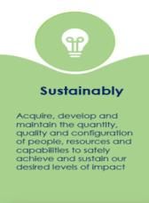
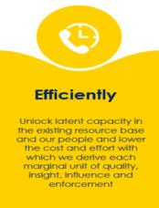
Capacitation eco-system
Successful and sustainable quality management process is dependent on adequate capacitation and coordination of critical internal resources and stakeholders
Our strategic aspiration focusing on strategic goals
Multi-disciplinary teams (IT, forensic, tax, legal)
Standards and regulatory bodies
Academic institutions
Collaboration with business
Investment in young professionals
Automation and technology
Quality Management
Nutrition/Transport
Notes:
This template was inserted from Power-user, the productivity add-in for PowerPoint, Excel and Word.
Install Power-user to access thousands of templates, icons, maps, diagrams and charts with Power-user.
Visit https://www.powerusersoftwares.com/
©Power-user SAS, terms of license: https://www.powerusersoftwares.com/terms

Slide 5
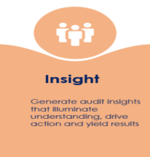
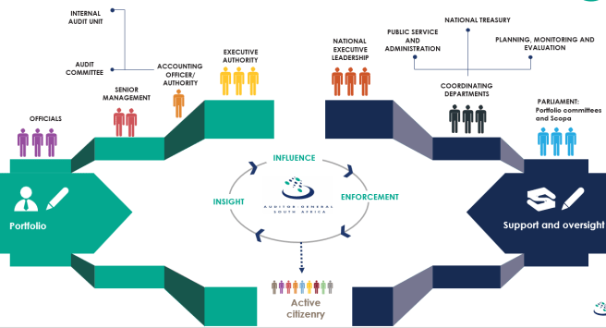
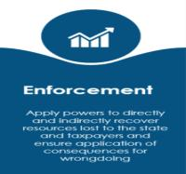
Audit impact and accountability eco-system
Critical that SAIs audit what matters and have maximum impact on the support provided to key stakeholders.
As SAI South Africa, we are committing ourselves to making a more direct, consistent and meaningful impact on improving the lived reality of ordinary South Africans over the next seven years
Accountability Ecosystem
Broad-based, effective network of stakeholders driving and deepening public sector accountability
Our strategic aspiration focusing on strategic goals
Nutrition/Transport
Notes:
This template was inserted from Power-user, the productivity add-in for PowerPoint, Excel and Word.
Install Power-user to access thousands of templates, icons, maps, diagrams and charts with Power-user.
Visit https://www.powerusersoftwares.com/
©Power-user SAS, terms of license: https://www.powerusersoftwares.com/terms

Slide 6
Stay in touch with the AGSA
THANK YOU
www.agsa.co.za
Auditor-General of South Africa
@AuditorGen_SA
Auditor-General of South Africa

