Slide 1
CAROSAI
“Our Journey Through The Years”
Presented by: Pamela Monroe Ellis
Auditor General-Jamaica
Secretary General-CAROSAI

Slide 2
1986 CAROSAI was conceptualized by heads of SAI Guyana, St. Lucia & Trinidad & Tobago with the assistance of AG-Canada.
1988-Charter to establish CAROSAI adopted & signed by delegates of 9 independent Caribbean Countries.
Inaugural Congress held in Port of Spain-August 8-10, 1988
1993-CAROSAI incorporated as a legal entity in Trinidad & Tobago by Act No. 15 of 1993
A Timeline of Our Establishment

Slide 3
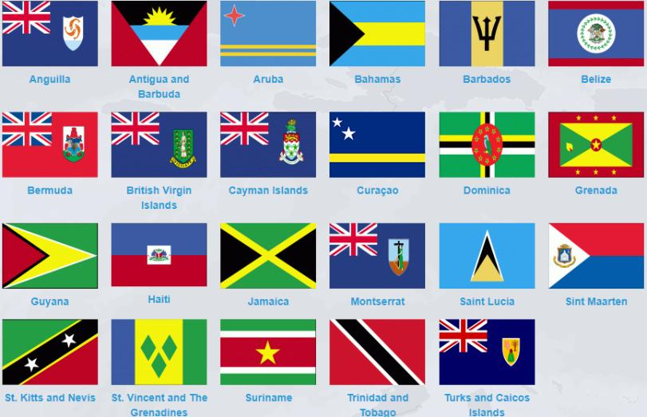
CAROSAI’s Membership Today
23 MEMBERS
In recent times, CAROSAI has received expressions of interest from other SAIs for membership.

Slide 4
The challenges we’ve faced
Limited access to each other
CAROSAI’s EC met once every 3 years.
Limited Financial Resources
This also impacted our ability to meet and execute planned activities.
Technological & Communication Issues
No access to technology to support virtual meetings.
With support of World Bank an SBP was prepared, however planned activities & outcomes were not shared with all SAIs

Slide 5
Time for Change

Slide 6
The Turning Point
We came together and agreed on our challenges, limitations & strengths.
A decision was also taken to not receive assistance from donors in preparing the strategic plan.
All SAIs signed off on the Strategic Business Plan
Targets were kept manageable and achievable
Key priorities were determined as a team.
With the assistance of IDB monthly meetings were made possible
They loaned us their video equipment
2016 Congress Suriname

Slide 7
CAROSAI’s Three Pillars
1
High Quality Audits
2
Strategic Performance Measurement
3
Effective Stakeholder Engagement to Maintain Relevance

Slide 8
CAROSAI’s Three Pillars
1
High Quality Audits
2
Strategic Performance Measurement
3
Effective Stakeholder Engagement to Maintain Relevance

Slide 9
Key activities delivered under Chairmanship of Suriname
Administration of CAROSAI’s eLearning Platform
Collaborative Procurement Audit Programme
IDI Sustainable Development Goals-Audit
IDI SAI-PMF
IDI SPMR
INTOSAINT IDI SPMR
IDI Strategic Engagement of Stakeholders

Slide 10
Fostering Partnerships
2018
CAROSAI signed a Memorandum of Understanding with the Institute of Chartered Accountants of the Caribbean (ICAC)
This was aimed at creating a regional pool of resource persons, coordinate training programmes & support the development of mechanisms aimed at quality assurance through peer reviews.

Slide 11
Implementation of our SBP
1-High Quality Audits
2 collaborative audits successfully completed
2-Strategic Performance Measurement & Reporting for Effectiveness
Completion & implementation of the recommendations for SAIs in INTOSAINT programmes
Participation & conclusion of SAI/PMF training
3-Effective Stakeholder Engagement to Maintain Relevance
Stakeholder engagement planning workshops were convened in Kingston & Cape Town.
SAIs were encouraged to build their own SEP.
3D Health Audit
Transparency, Accountability & Inclusiveness (TAI) Audit
PESA-P Pilot
LOTA Scan Programme
CAROSAI is participating in the Global SAI Accountability initiative GSAI Project
8 members successfully completed their stakeholder engagement plan.

Slide 12
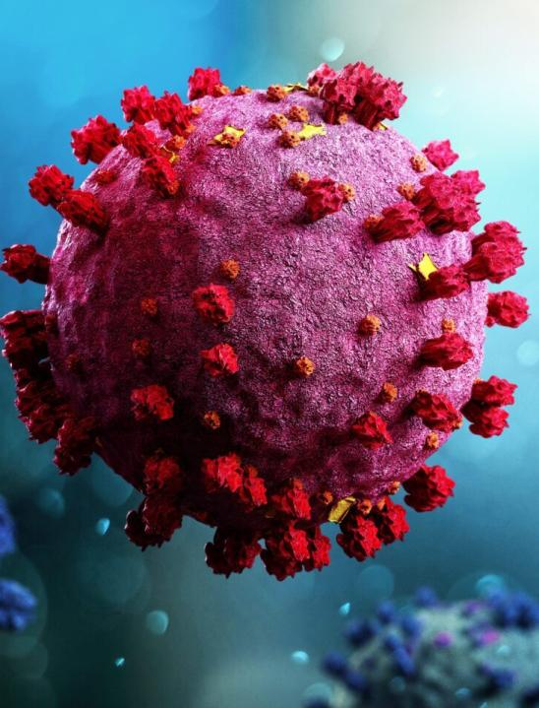
CAROSAI’s Resilience Tested
The COVID pandemic started affecting the Caribbean in March 2020.
Despite this, CAROSAI was able to implement at least 76% of plans targeted for the period.

Slide 13
Engaging with our Stakeholders via Webinars
Use of Technology During this Time
Demystifying Data Analytics
Quality Management Standards
Audit of the Future
Climate Change Adaptation Actions

Slide 14
Survey Results/Findings
Surveys were administered during the pandemic to assess the impact on members’ operations as well as to determine their needs.
Insufficient structured training exacerbated by less than desirable % of qualified staff.
Limited access to relevant technology, both computer hardware and software.
Impaired SAI independence
Lack of access to technology & structured training at local level amongst SAIs in Caribbean.
Males enjoy a higher level of qualification than their female counterparts.

Slide 15
XII Congress ARUBA-2022
“Targeting Superior Audit Impact”
The Lead Paper presented focused on:
Professionalization of SAIs
Expanding audit focus to include emerging issues (Technology & real-time audits)
SAI Governance
SAI Independence
SAIs were encouraged to use limited resources and find innovative means to report independently & follow-up on audit findings.

Slide 16
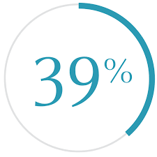
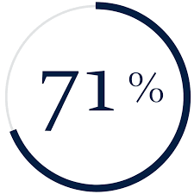
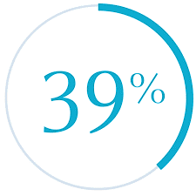
INTOSAI 2020 Global Stock Taking Report
Of members have implemented the standards for financial audits.
Have implemented the standards for performance audit.
Have a quality assurance system.

Slide 17
Building a Better CAROSAI
We will seek collaboration and sponsorship to increase our capacity development.
In the interim, we will be collaborating with CIPFA, PASAI and the CBC to put forward challenges being faced by small island developing states and look forward to mitigating said challenges.

Slide 18
LOOKING AHEAD
Looking Ahead

Slide 19
Following 2022 Congress, the conclusions contributed to the development of CAROSAI’s 2023-2025 Strategic Business Plan.
1
Responsive & Effective SAIs
2
Relevant SAIs
3
Effective Stakeholder Engagement to Maintain relevance
4
CAROSAI Governance

Slide 20
Upcoming Activities Based on Strategic Priority Areas
S1-Responsive & Effective SAIs
Promote effective independent & professionalization of SAIs
Capacity development initiatives
S2-Relevant SAIs
Cooperative audits
S3-Stakeholder Relationships
Engagement with stakeholders
Good governance advocating for independence
Develop pool of regional quality assurance reviewers
Collab with IDI-SAI PMF
Climate change
Real-time audits
Support digitization of SAI audit practices.
Cross-cutting audits.
Discuss how SAIs facilitate improvement in public sector
S4-CAROSAI Governance
Internally focused
Needs driven SAI level support
Performance monitoring & evaluation
Effective communication
Organizational management & support structure

