Slide 1
A perspective on the role of accountants and auditors through a PFM lens
Laura Leka
Principal, International Federation of Accountants
INTOSAI CBC Regional Forum
Kingston, Jamaica
22nd June 2023

Slide 2
About IFAC
IFAC is the global organization for the accountancy profession
IFAC’s membership is comprised of 180 members & associates in 135 jurisdictions
Representing more than 3 million professional accountants worldwide (over half work in business and industry, the public and not-for-profit sectors)
Serve as the global voice for the profession
Work with our member organizations and others to ensure the profession is future-ready
Support the adoption of international standards
Our strategic objectives

Slide 3
“While frameworks and standards are crucial to strengthening PFM, having the right people, with suitable training and the right skills and competencies across governments and public sector entities, is fundamental.”
IFAC’s Point of View: Greater Transparency and Accountability in the Public Sector | IFAC

Slide 4
Opportunities in the PFM cycle
Policy and Planning
Budget Preparation & Approval
Budget Execution
Accounting and Reporting
External Audit
Legislative Oversight
While typically associated with “accounting and reporting” and “external audit”, professional accountants can have involvement across all elements of the PFM cycle
Requires cooperation and collaboration with many other role players and navigation of political challenges

Slide 5
Priorities for the accountancy profession
Expand public sector accountant membership within PAOs
Increase professionalization in public sector finance
Must improve the whole system - including accountants, auditors, internal audit, politicians, budget holders, and counter fraud specialists
Apprenticeship schemes and accounting technician qualification routes are key to professionalizing those already working in public sector
Consider future learning and development needs and highlight the career paths for public finance staff
Attracting and retaining talent

Slide 6
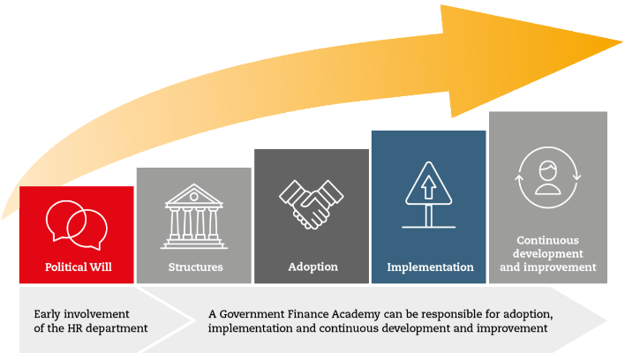
The journey to full professionalisation
READ MORE: A Global Guide for Professionalisation in Public Sector Finance | IFAC | ACCA

Slide 7
Professionalisation: Country case studies
Advocacy partners for political will
Tanzania – laying the foundations
Building structures, including legislative / regulatory frameworks
UK’s Government Resources and Accounts Act & Government Finance Function
Gap analysis & competency frameworks for adoption
Cyprus: the sovereign debt crisis creating urgency for change
Philippines: developing a competency framework
Matching skills and systems: ACCA supporting PFM reform in Pakistan
African Professionalisation Initiative
Recruitment and upskilling to support implementation
Cyprus: sourcing skills from the private sector
Malaysia: professionalising the Supreme Audit Institution
Professionalisation in Tanzania
READ MORE: A Global Guide for Professionalisation in Public Sector Finance | IFAC | ACCA
Developing a cross-function finance function for continuous improvement
NHS Wales: learning from others
Malaysia: building networks
UK Centres of Excellence and National Audit Office

Slide 8
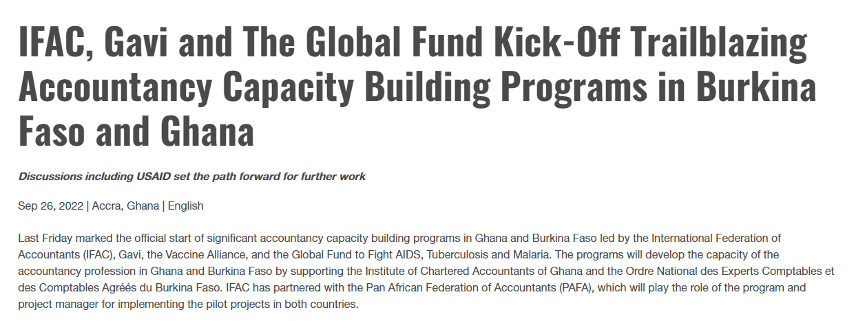
Global collaboration

Slide 9
Appendix: Example PAO activities in the public sector
Institute of Chartered Accountants of Barbados (ICAB)
Ongoing collaboration with Government of Barbados on PFM
Institute of Certified Public Accountants of Rwanda’ (ICPAR)
Partner with the Government of Rwanda’s Ministry of Finance to develop skills and competencies
Saudi Organization for Chartered and Professional Accountants
Focus on empowerment of women has led to increase in female accountants in the public sector
African Professionalisation Initiative (API)
Competency framework and accelerated learning curriculum for public sector finance
(Partnership includes PAFA + AGs, SAIs, and PAOs across Africa)
Chartered Accountants Ireland
Working with Irish government on public sector accounting reform; training, member support, and research, including a landmark position paper
Chartered Institute of Public Finance and Accountancy (CIPFA)
Compendium of global anti-corruption case studies; launching new international qualification in corruption risk assessment
Confederation of Asian and Pacific Accountants
Supporting PAOs make a difference in the public sector: Framework and case studies
IFAC/ACCA
Global Guide for Professionalisation in Public Sector Finance
Professionalisation case studies: Malaysia, UK, Cyprus, Tanzania, the Philippines, and Pakistan

