Slide 1
Peer-to-Peer Capacity Development Support to Supreme Audit Institutions
Susanne Wille
Directorate-General for International Partnerships
E1 Macro-economic Analysis, Fiscal Policies and Budget Support

Slide 2
The study presents
A mapping of P2P actions implemented by SAIs globally with information on the various dimensions of each action
An analysis of the P2P landscape providing an understanding of the conditions that make P2P relevant, efficient, effective, sustainable and value adding.
Lessons learnt and recommendations identifying good practices, constraining factors and bottlenecks and how they could be addressed.

Slide 3
Basic parameters
Peer-to-peer cooperation in essence involves at least one SAI supporting another SAI’s capacity development through a structured medium to long-term (1-3 years, or longer) partnership. The shared principles and standards of the INTOSAI community – the INTOSAI Framework of Professional Pronouncements – provide the framework for the cooperation.
Timeframe: 2015-2022

Slide 4
Data used
the SAI Capacity Development Database
the INTOSAI Global Survey 2020
a questionnaire (survey) which targeted the largest P2P providers.
Focus group discussions for the case studies

Slide 5
The P2P lands cape in short
A total of 118 projects have been identified in the period 2015-2022 as P2P actions (may be not complete)
Approximately one-third of capacity development activities recorded in the database (and in the additional information received) can be considered a P2P action. (with caution)
The duration of a P2P action varies widely from about 6 months up to 21 years. The estimated average duration of a P2P action is 3.6 years.
P2P actions typically cover a combination of multiple topics. In the audit domain, performance audit is most popular (49%) followed by financial audit (46%).
The budget ranges from EUR 10 thousand to over EUR 12 million for a 19 year support. In 60% of the projects, the funding was fully or partially provided by external sources

Slide 6
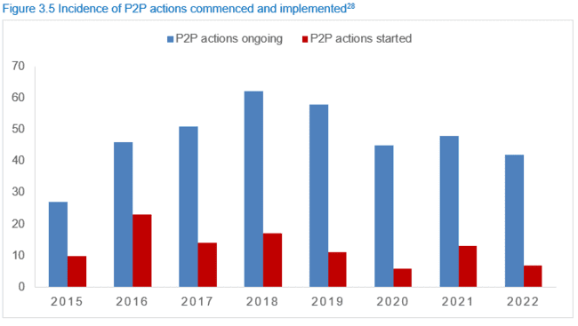
The P2P lands cape in short

Slide 7
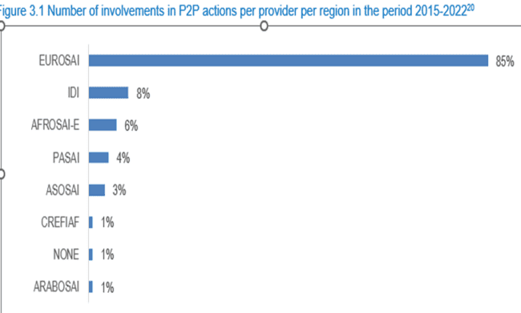
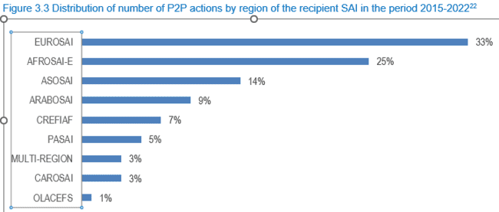
The P2P land scape in short

Slide 8
Some good practices
Demand-driven capacity development approach aligned to the specific context and strategic plan of the recipient SAI, with high level engagement and ownership from all partners;
Applying a flexible and agile approach to adapt to changes in needs and circumstances during the implementation of the cooperation;
a combination of intra-regional peers (context, language and cultural similarities) and inter-regional peers (specific expertise) where appropriate;
A results framework and monitoring to promote learning, adaptation and optimisation of the impact.
Applying strong results-based project management systems and coordination mechanisms, in particular in situation with more than two partners;

Slide 9
Some constraining factors
Challenges in finding a suitable partner SAI;
Insufficient funding available
Insufficient absorption capacity on the side of the recipient SAI;
Insufficient human resources available at the provider SAI for instance due to a (temporary) shift to domestic priorities;
Project management requirements;
Lack of a legal mandate of some (potential) provider SAIs

Slide 10
Thank you for your attention
This was a short summary, much more information is in the report.

