Slide 1
WELCOME TO WEBINAR 2
The value of HR – how strategic HR can help your SAI succeed

Slide 2


PURPOSE OF WEBINAR 1
Learn how to build HR as one connected system using INTOSAI tools
Understand how to develop and implement a competency framework
Encourage regional networks and collaboration on HR matters
AGENDA
Building competence & HR systems – INTOSAI’s HR tools
The Competency Framework – the heart of strong HR
Guest Speaker – experience from the Court of Accounts Moldova
Support, networks, and next steps
Q&A
Conclusion
WEBINAR 2 THE VALUE OF HR

Slide 3





ISSAI 150: THE FOUR REQUIREMENTS
2.
Build these competencies through HR practices
1.
Identify the competencies auditors need
3.
Provide structured pathways for professional development
ISSAI 150
4.
Assess and monitor competencies regularly
WEBINAR 2 THE VALUE OF HR

Slide 4

GUID 1950: BUILDING A COMPETENCY FRAMEWORK
Explains how to create a competency framework
Defines skills, knowledge, and behaviours auditors need
Supports:
  Recruitment
  Training
  Performance management
Career development
WEBINAR 2 THE VALUE OF HR

Slide 5

GUID 1951: BUILDING DEVELOPMENT PATHWAYS
Shows how to develop career and learning pathways
Includes a 10‑step process:
  Identify gaps
  Design development programmes
  Assess learning results
Helps SAIs build a professional development system
WEBINAR 2 THE VALUE OF HR

Slide 6

CBC HR MANAGEMENT GUIDE
Created to make ISSAI 150 and the GUIDs easier to understand
Explains HR concepts in simple and practical terms
Helps SAIs understand how all HR processes fit together
WEBINAR 2 THE VALUE OF HR

Slide 7

INTERACTIVE SEGMENT
Has the endorsement of ISSAI 150 brought change in the way you manage HR in your office?
Please write a short phrase in the chat.
Options:
Determine and document competences
HR processes and routines
Professional training and development
Assessment of competences
WEBINAR 2 THE VALUE OF HR

Slide 8
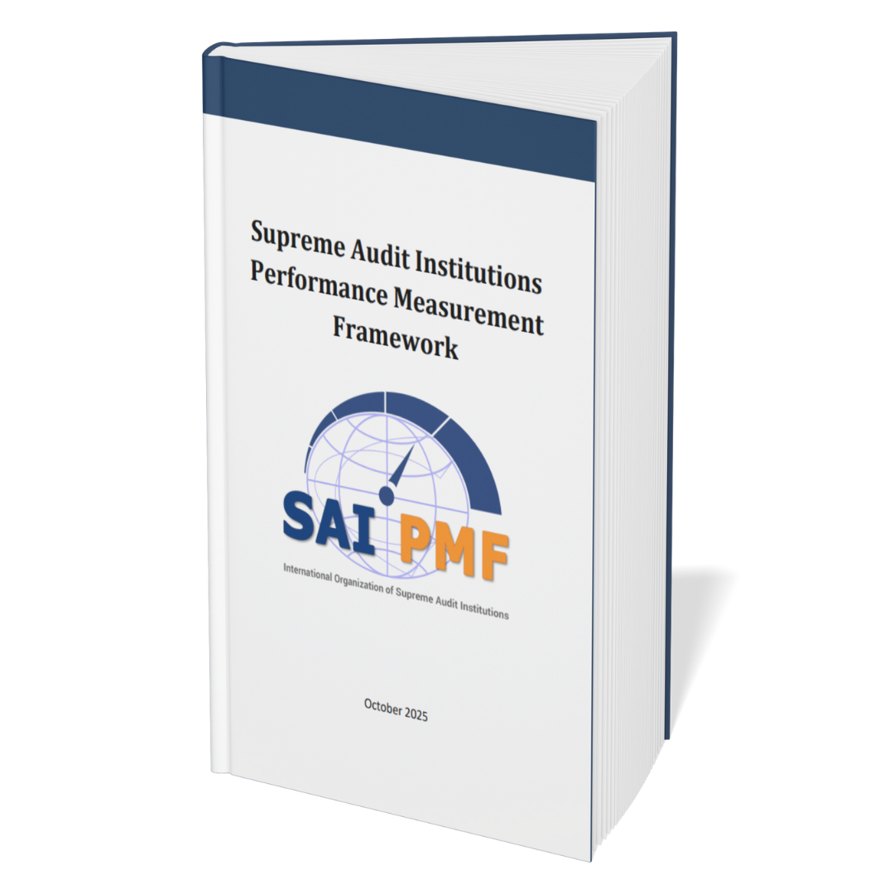
SAI PMF (DOMAIN E): CHECKING HR IN PRACTICE
Created to make ISSAI 150 and the GUIDs easier to understand
Explains HR concepts in simple and practical terms
Helps SAIs understand how all HR processes fit together
WEBINAR 2 THE VALUE OF HR

Slide 9

Competency
Framework
A perfect start for successful practical implementation of ISSAI 150
The SAI Moldova Experience
Presented by Teodorina Goriuc ,
Head of Administration (Head of Staff)
The Court of Accounts of the Republic of Moldova (CoARM)

Slide 10
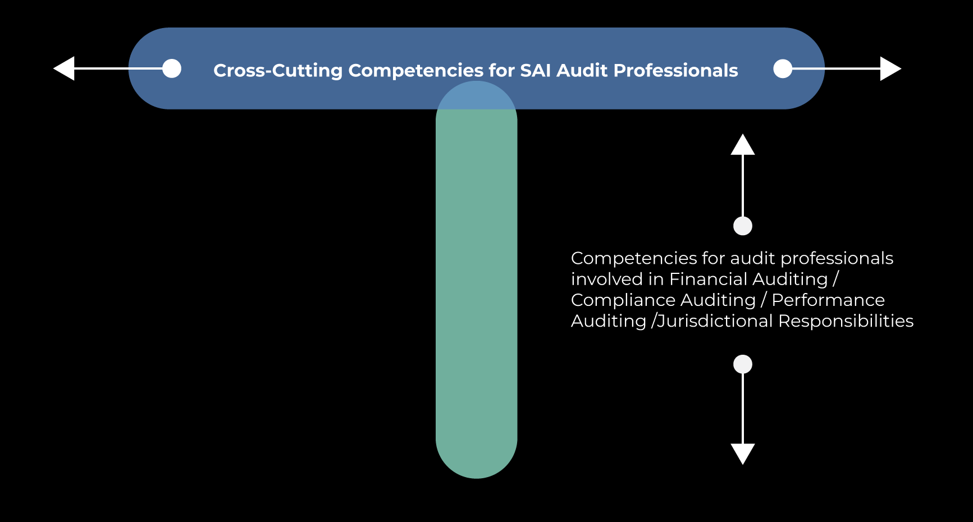

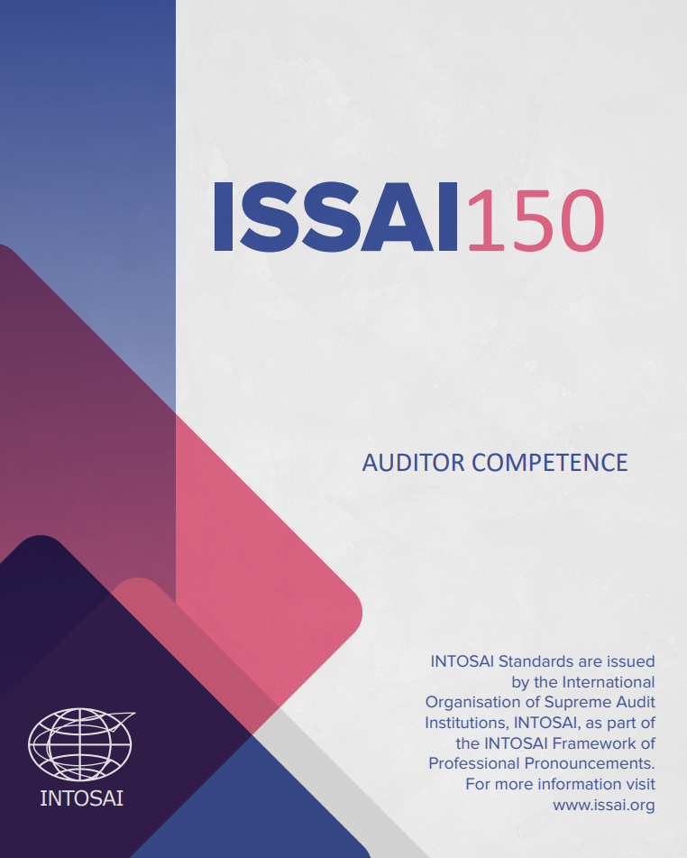
What is a Competency Framework?
A model
that details and defines the competencies expected of an individual auditor, group or team for a specific task and for a specific position within an organization.
reflecting the expectations of an ever-changing world.
define the elements needed to drive success and high performance, and will change depending on the circumstances

Slide 11
What is a Competency Framework?
A model
that details and defines the competencies expected of an individual auditor, group or team for a specific task and for a specific position within an organization.
reflecting the expectations of an ever-changing world.
define the elements needed to drive success and high performance, and will change depending on the circumstances

Slide 12
CoARM competency framework
Core specific competencies
Competences of employees in specialized fields
(specialist in communication and public relations, accountant, HR manager, etc.)
(developed in 2024 and sent out for use.
To be approved when revising CF)
not directly involved in external public audit activity
Financial audit
Compliance audit
Performance audit
IT auditor
Competences for team member
Competences for team member
Competences for team member
To be developed during 2026
developed in 2024 and sent out for use.
To be approved when revising CF
Competences for team leader
Competences for team leader
Competences for team leader

Slide 13
The system of professional competencies is a set of tools related to human resources management within a Supreme Audit Institution , being applicable throughout the life cycle of an employee within the institution.
Recruitment
Performance management
Training and professional development
Performance evaluation
Promotion by position or status
Leaving the institution
Notes:
Just illustrative ( no detailes)
Exemples of use of CF
Recruitment
In the evaluation process, the Competition Committee will ensure that the recruits meet at least 50% of the core competencies according to Annex 1 and 20% set out in the professional knowledge set out
Training
Specific ad-hoc trainings cover specific competencies
We have a certification scheme which aims to develop core competencies
Assesment of Competencies
Given the national specificity, as well as the particularities of the status of the employees of the Court of Accounts, the evaluation of professional competences, in terms of their correspondence with the competency profiles set out in the Annexes to this document will be carried out annually in the exercise of evaluating the performance of civil servants, by including the necessary comments in the Performance Evaluation Sheets of the civil servants.
The combination of these procedures will ensure the avoidance of duplication of tasks, ensuring compliance of human resources management processes with the requirements of the national regulatory framework, as well as with the rigors of international standards of supreme audit institutions applicable to the Court of Accounts of the Republic of Moldova.
We tried an innovative institutional tool to be tested during the first two years of implementation of the Professional Competence Framework is the self-assessment of professional competencies by the evaluated employee. But it didn’t necessarily prove useful and the interest in pursuing this exercise in the institution was low.

Slide 14
How the Competency framework helped CoARM?
Common Challenge
How the CF Helps
Line managers and engagement partners unclear on role expectations
CF defines competencies clearly — clarifies responsibilities, roles, boundaries
Subjective or unclear performance reviews
CF offers concrete criteria for feedback and evaluation
Hard to detect development needs
CF allows comparison between required and actual competencies
Promotion or rotation decisions disputed
CF provides a merit-based foundation for career decisions
CF enables targeted and personalized development planning
Ad-hoc or inconsistent coaching
SAI positioning and role in public administration is not perceived as clear
CF strengthens the credibility of the SAI by demonstrating that audit work is grounded in professional competence
Notes:
Why applying the Competence Framework (CF), based on ISSAI 150, helps audit subdivision managers
Clarity of expectations and professional requirements. The CF offers a transparent and standardized view of what is expected from auditors at each professional level. Managers no longer need to rely on subjective or unwritten criteria to assess performance or potential.
Support for objective performance evaluations. The framework provides clear indicators that can be integrated into regular performance reviews. This reduces the risk of bias or conflict and ensures a fair, well-justified assessment process.
Basis for identifying real training needs. By applying the CF, managers can more easily spot competency gaps within their teams and request targeted, relevant, and effective training, rather than relying on generic or poorly matched sessions.
Facilitates career development and staff retention. Staff who see a clear professional development path, supported by their managers, tend to be more motivated and less likely to leave. The CF helps managers offer tailored guidance and create meaningful development plans.
Helps optimize team composition and task allocation. Knowing each auditor’s actual competency level enables managers to form more balanced teams aligned with the mission profile, reducing the risk of overburdening or underutilizing staff.
Increases quality and efficiency in audit work. A team with well-calibrated and continuously developed competencies delivers more robust results with fewer corrections, reducing the managerial burden of rework or excessive review.
Applying the CF demonstrates institutional compliance with ISSAI requirements and readiness for external assessments (e.g., peer reviews), enhancing institutional credibility and confidence in audit teams.

Slide 15
Challenges and lessons learned
Why was it hard?
What we could have done differently
The new ISSAI was new for everyone
The desire to be fully compliant to ISSAIs
National framework applicable to our employees
First impressions that the CF will result in additional work for everyone
Define and explain what “compliance to ISSAIs” means to us as a SAI
Begin with a blank slate and simplify everything for clearer understanding

Slide 16
What worked well
Had clear support from top management (Head of SAI) in promoting the need and added value of the implementation of a CF.
Promoted the fact that de CF is an instrument to help staff, not assess or “punish” them.
Involved line managers in the CF development from the start and have preliminary meetings at every step of the way.
Defined competencies in terms of observable behaviors, rather than abstract qualities. When finalizing the drafts, consulting it and compromising on the understandable wording for everybody.
Brainstormed a lot at the beginning to make sure we integrate the CF in every existing HR process, such as recruitment, performance management and assessment.
Accepted that the CF (as it was approved in 2022) is a work in process, with additional steps to be taken in the upcoming years

Slide 17
Added value of the implementation of the CF
Institutionalization of existing practices within the CoA, to ensure compliance with the requirements of the INTOSAI Professional Pronouncements Framework, while at the same time keeping it simple;
Creating benchmarks for recruitment, professional development (at different job levels) and employee promotion within the institution;
Promoting the professionalism of CoARM employees both internally and in society, while strengthening the trustworthiness of SAI products.

Slide 18
Q&A
And now it is time to look at what questions we have from you.
If you have questions, please write them in chat!
WEBINAR 2 THE VALUE OF HR

Slide 19

SUPPORT, NETWORKS, AND NEXT STEPS
Learn from peers – actively seek tools, lessons and practical insights from others
Leverage your region – make us of what your region has to offer, or ask them to obtain materials from others
Engage global support – INTOSAI has some initiatives that can support you
Collaborate intentionally – access a community of practice, or create one yourself
WEBINAR 2 THE VALUE OF HR

